Slide 1
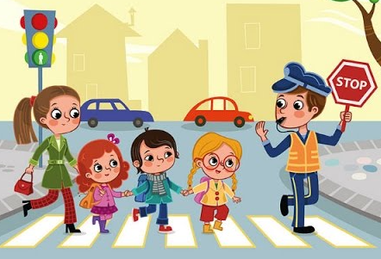
Hazel PSHE Knowledge Organiser Spring Term 1 – Keeping safe and managing risk
Indoors and Outdoors
Books to help with this topic:
Dinosaurs beware – a safety guide, Marc Brown
Key Vocabulary
safety | Protected from danger
danger | Situation that could cause harm
risk | Situation that could be dangerous
hazards | A danger or risk
What we should know and what we should be able to do:
To learn about keeping safe in the home, including fire safety
•I know some simple rules for keeping safe indoors, including online
•I can describe what to do if there is an emergency
•I understand that I can take some responsibility for my own safety
To learn about keeping safe outside
•I know some rules for keeping safe outside
•I can assess whether a situation is safe or unsafe
•I understand the importance of always telling someone where I am going or playing
To learn about road safety
•I can identify hazards in relation to road safety
•I am able to explain how to cross the road safely
•I recognise that there are rules in relation to road safety for all road users
Questions to think about …
What rules keep us safe at home or inside school?
What should I do in an emergency?
Why should I always tell an adult where I am going?
How do I know if a situation is safe?
How do I cross the road safely?
What are the rules for crossing the road?
Useful Websites:
Always talk to someone who helps keep you safe, such as a parent, teacher or other adult you trust.
ChildLine: 0800 1111 www.childline.org.uk
Think! Education, road safety resources for pupils http://think.direct.gov.uk/education/early-years-andprimary/
• KS1 PSHE and citizenship class clips, BBC Bitesize, video clips about road safety www.bbc.co.uk/education/subjects/zmpfb9q
KS1 PSHE and citizenship class clips, BBC Bitesize, video clips about safety in the home www.bbc.co.uk/education/subjects/zmpfb9q

