Slide 1

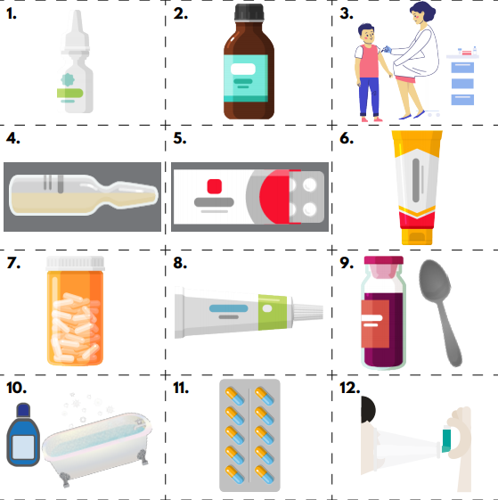
Hazel PSHE Knowledge Organiser
Spring Term 2 – Drug, alcohol and tobacco education
Medicines and Me
Books to help with this topic:
Key Vocabulary
medicine | A drug given to you by a doctor, nurse or trusted adult to help you feel better
vaccination | An injection to protect you from particular illnesses
recover | Get well and healthy
inhaler | A thing that gives you a drug to help your breathe if you have asthma
What we should know and what we should be able to do:
NC objective:
Pupils learn why medicines are taken
Outcomes:
Pupils • understand the purpose of medicines is to help people stay healthy, get well or feel better if they are ill • know that medicines come in different forms • recognise each medicine has a specific use
NC objective:
Pupils learn where medicines come from
Outcomes:
Pupils • know that medicines can be prescribed by a doctor or bought from a shop or pharmacy • know when medicines might be used and who decides which medicine is used • understand that there are alternatives to taking medicines, and when these might be helpful
NC objective:
Pupils learn about keeping themselves safe around medicines
Outcomes:
Pupils • understand that medicines comes with instructions to ensure they are used safely • know some safety rules for using and storing medicines • recognise that medicines can be harmful if not taken correctly
NC objective:
ASTHMA LESSON FOR YEAR 2 Pupils learn that medicines can be used to manage and treat medical conditions such as asthma, and that it is important to follow instructions for their use
Outcomes:
Pupils • know what asthma is and how it can affect people • can recognise the symptoms of an asthma attack • understand how people with asthma can look after themselves – treating asthma as a condition and treating an asthma attack
Questions to think about …
What do different medicines look like?
Who gives us medicines?
Who should you tell if you feel unwell?
What safety rules are useful for medicines?
Useful Websites:
Always talk to someone who helps keep you safe, such as a parent, teacher or other adult you trust.
ChildLine: 0800 1111 www.childline.org.uk
Call 999 if anyone is in danger or you think there is an emergency

Slide 2
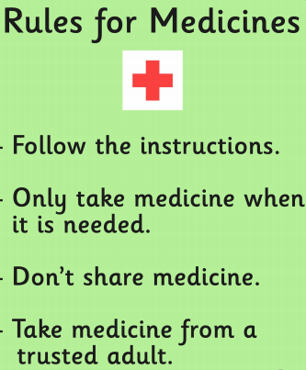
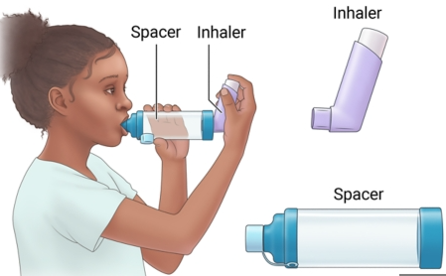
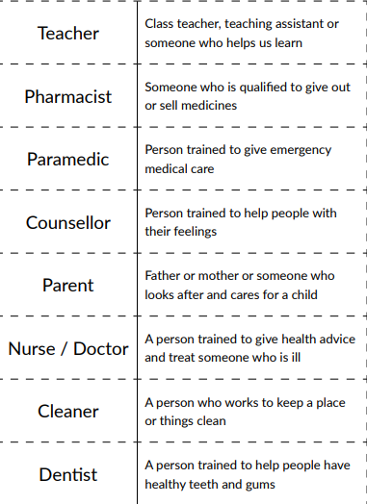
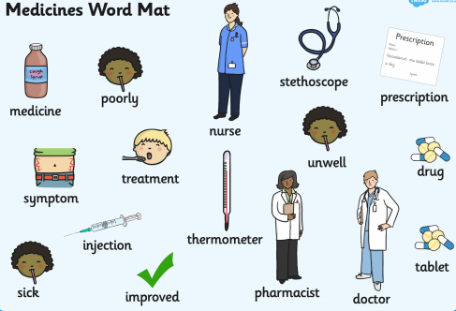

People who help us with health

