Slide 1
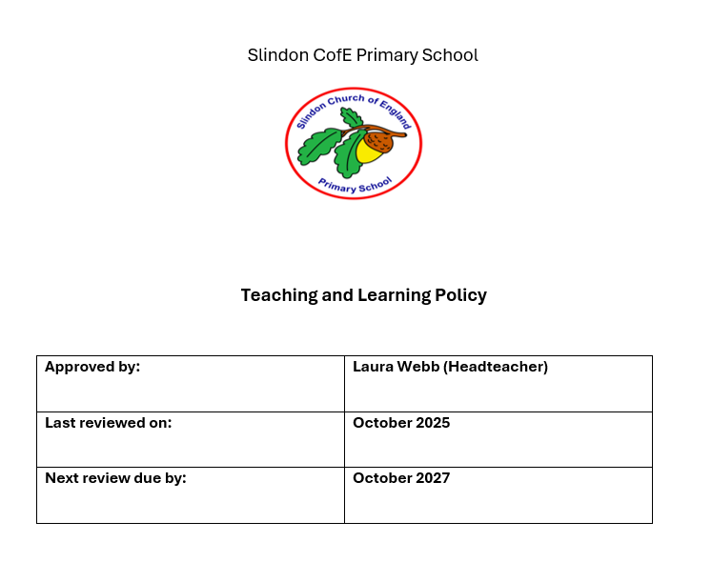

Slide 2
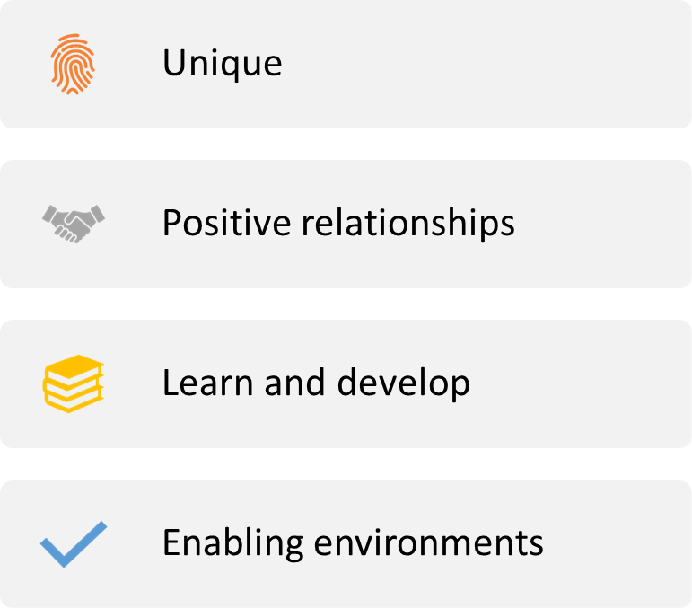




Slide 3
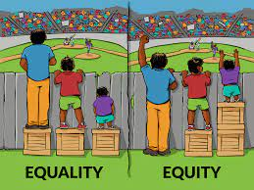
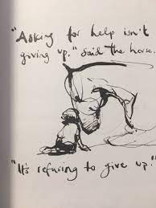
Contents
.Introduction
.Our School Week
.Teaching and Learning
.Rosenshine’s Principles
.Retrieval Practice
.Metacognition & Self-Regulated Learning
.SEND
.Vocabulary
.Questioning and Feedback
.Live Modelling
.The Importance of Routines
.Behaviour
.Homework
.Mathematics
.Reading and Writing
.Science
.Religious Education
.Foundation Subjects Planning
Pupil voice and monitoring.
.Assessment
.Appendices

Slide 4

Introduction
Children learn far more than just the curriculum in schools. We try to build and develop children’s character, instil in them values, teach them good manners, build confidence, poise, thoughtfulness and much, much more. Schools know that even if children are exposed to views and behaviours that are far from ideal, schools can and must make a difference!
It is vital in our role that in helping children to develop into adults we would admire and respect, that what we do in helping our children develop their character into something that will not only shape the community they live in, but also change the world they belong to. We remind all of our children on a regular basis what they could achieve through hard work and believing they make a difference.
In the classroom the children should receive Quality First Teaching (QFT) where their needs are met through small-step instruction. Effective modelling of worked examples and non-examples (contrast) reduces the chance of misconceptions. Scaffolding and differentiation provides children with the structure to attain highly and build confidence. Teachers need to be economical and efficient with their language. This will help children in managing their working memory and it allows the child to immediately think of the task. ​
Our curriculum is knowledge rich and whenever possible, practical. There is a focus on children gaining a deep understanding of the knowledge taught. This is very dependent in the depth of knowledge of the teaching staff. The sequence of learning is carefully considered and planned, so the skills and knowledge is built on year-on-year.

Slide 5
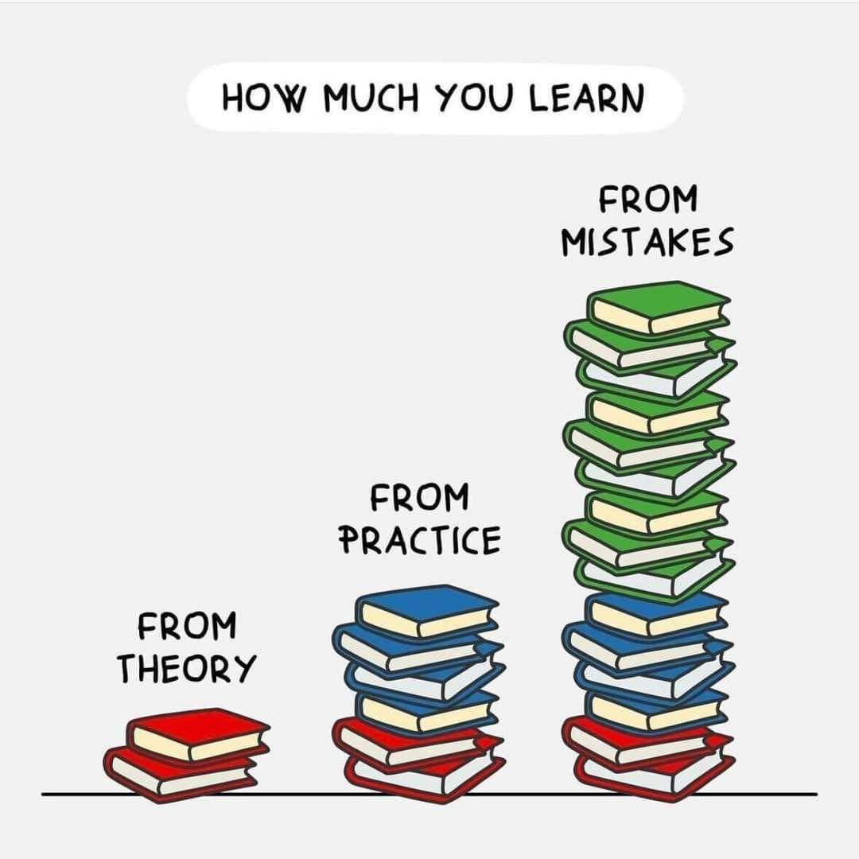
What does good teaching look like?
Good Classroom Management – Good teachers have an ordered and calm classroom, whilst making effective use of all resources including space and time. Behaviour will be good and positive. On occasions there is any negative behaviour, the teacher will deal with it promptly with a minimum of fuss. Children will be able to vocalise what they are learning.
There will be no low level disruption or apathy towards learning, children should not be passively listening, they should be actively engaged.
Relationships – Positive relationships between teachers and children are key to enable the child to reach their full potential.
High Expectations – At all times teachers should have high expectations of their children regarding, behaviour, effort, quality of work and presentation of work. This should be for all of the children and should be consistent.
Challenge and Support – Our goal is to make the children’s learning challenging and trying to stretch their thinking. Through modelling, effective questioning and scaffolding, amongst other aspects to a teachers' armoury, the children will be supported where necessary.
​Retrieval Practice - teachers need to constantly check the children are learning effectively and this requires checking on prior learning. Having low stakes tasks from previous learning is essential moving information from the short term to the child’s long-term memory. Teachers need to offer challenge and a mixture of tasks that need recall from across the curriculum.

Slide 6
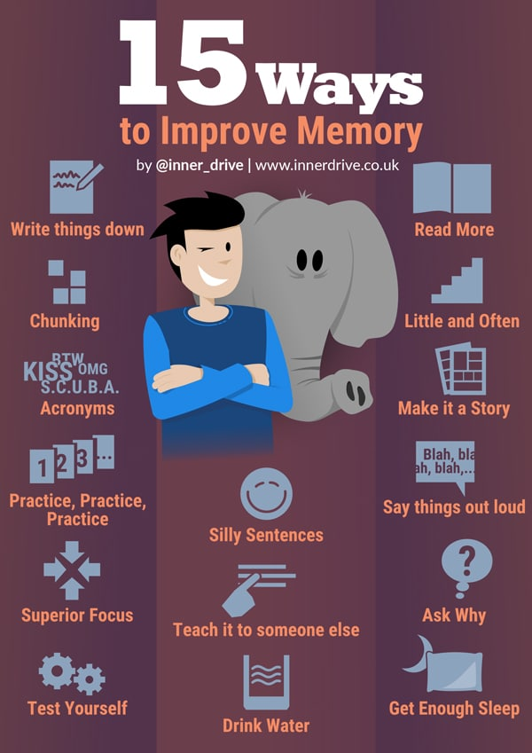
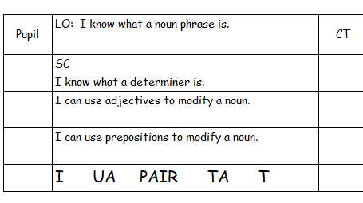
​
Feedback – This should be clear and precise, which tells the child where they are now, where they need to be and offers practical ideas on how to get there. A variety of feedback is essential and it must give ​children an opportunity to reflect on their work as well as the feedback. ​
​
Plenaries – A plenary is a great way to end a good lesson. A plenary should revisit the learning, success criteria and gather evidence about what has been learned. ​
​
Learning Intentions – This sets the tone of the lessons and outlines to the children what they are aiming to achieve as well as how the children are going to achieve. Incorporating what good learning looks ​like are key. ​
Remember, we are focussing on what they are learning, not what they are doing.
Success Criteria
Lessons should have a clear success criteria, which is focussed on the learning.
Planning- All planning should be in the staff drive, prior to it being taught. All planning should be adapted and not just taken off the shelf.

Slide 7

Our School Week
For every lesson, children need to know what lesson they are engaging with, so children need to aware if the lesson is a history lesson and not a ‘topic’ lesson.
There is an expectation to teach the following subjects:
English (reading, writing and speaking & listening) - five times a week
Maths—five times a week
Physical Education —twice a week (two hours)
Religious Education—once a week (one hour for KS1, One hour 15 for KS2)
Science—one hour 15 per week.
Art and Design—one lesson per week
Computing—one lesson per week (although looking for opportunities to include in other subjects)
Design and Technology—block teaching
Geography & History—two lessons per week
MFL (French in KS2) - once a week from year three to year six (30 minute lessons).
Music—in KS1 once a week; key stage two once a week
PSHE—once a week for 40 minutes.
Often Art and Design and Design and Technology are taught in extended periods e.g. across an afternoon or throughout a day.
When the class have their Forest School sessions, this replaces one Physical Education lesson. Also, if the school are attending swimming sessions this replaces one Physical Education lesson.
Oracy is taught through the foundation subjects, as well as within English sessions.

Slide 8
The Teaching and Learning cycle ensures medium-term planning has the right impact on our children’s progress and attainment. The focus must be on what the children are learning and not the task. Our fundamental questions when devising medium-term planning are:
♦ What can the children already do? What have they already learnt (prior knowledge)?
♦ What do the children need to understand next?
♦ What new vocabulary do the children need to learn? How are they going to show they understand new vocabulary?
♦ How can I facilitate the children to learn the key knowledge and skills?
♦ How will the children and teacher know they have been successful?
♦ What will their feedback be at the different stages?
♦ What are the next learning opportunities linked to this learning (future learning)?
What are the next learning opportunities linked to this learning (future learning)?
What can the children already do? What have they already learnt (prior knowledge)?
What will their feedback be at the different stages?
What do the children need to understand next?
How will the children and teacher know they have been successful? What is the assessment opportunity?
What new vocabulary do the children need to learn? How are they going to show they understand new vocabulary?
How can I facilitate the children to learn the key knowledge and skills?

Slide 9
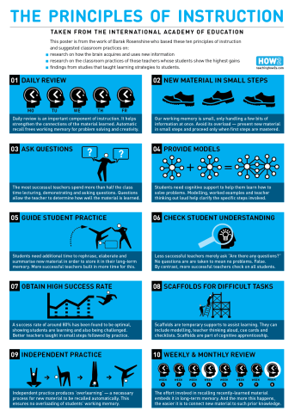
Rosenshine’s principles of instruction provide the basis for the transfer of subject knowledge from teacher to children in lessons. All teaching staff have read the 2012 paper https://www.aft.org/sites/default/files/periodicals/Rosenshine.pdf, which is revisited at regular intervals through whole school CPD.
Name the steps:
I do; we do; you do
Do Now!
Exit Ticket
I do; we do; you do
Examples
No opt out
Cold call
Wait time
Right is right
Stretch it
Circulate, Check, Respond (CCR)
Self report
Exit tickets
Break it down
Responsive teaching
Break it down
Name the steps
Completion problems
No opt out
Retrieval Practice
Lots of
practice

Slide 10
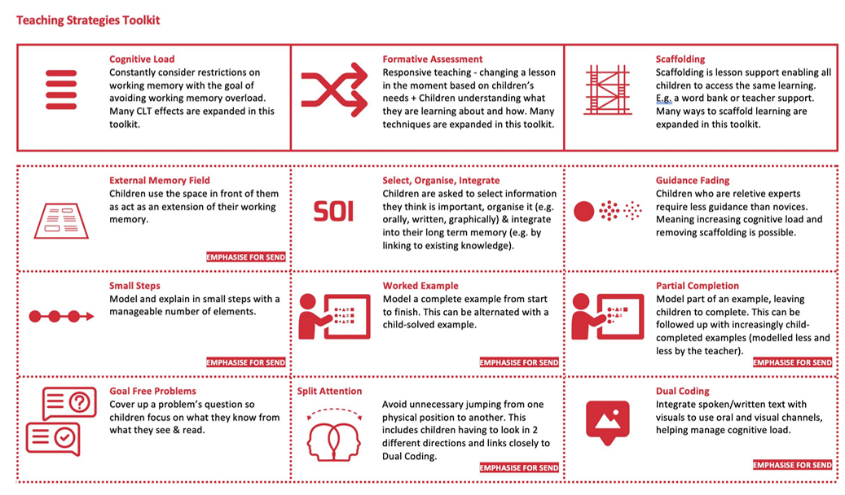

Slide 11
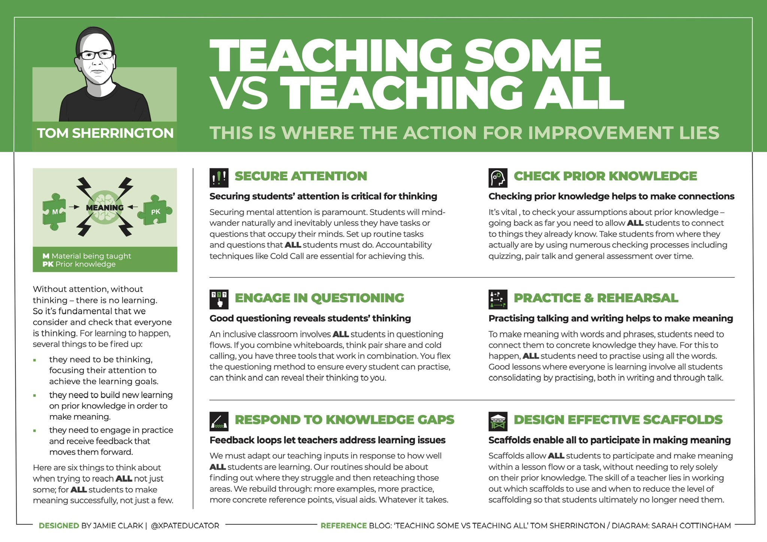

Slide 12
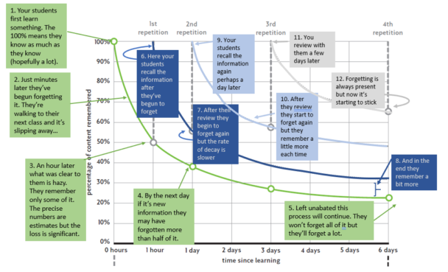
Retrieval Practice is part of every lesson that is taught in our school. The expectation from every teacher that they incorporate an aspect of retrieval into their lesson and this must include objectives from last week, last term and last year, which should be seen in the teachers planning. Retrieval Practice is supposed to be short (no more than five minutes), immediate feedback and enable the children to retrieve previously taught information independently where the child reconstructs something they have learned previously from memory and thinking about it right now. Therefore, our children take part in mini-quizzes (Sotola & Credé (2020)) and retrieval activities to strengthen their memory. These activities involve everyone and can include:
♦ Make checking accurate and easy; whiteboards are great for this!
♦ Quick fire quizzes e.g. paper, Socrative, labelling a picture, paired quiz
♦ Keep it generative
♦ Make it time and workload efficient
♦ Specify the knowledge
♦ Self explanation
♦ Tell the story; analysing and connecting images
♦ Summarising (in 15/45/100 words)
♦ Challenge grids
♦ Flashcards
♦ Draw what you remember
♦ Orally explaining to a peer, teacher or teaching assistant

Slide 13
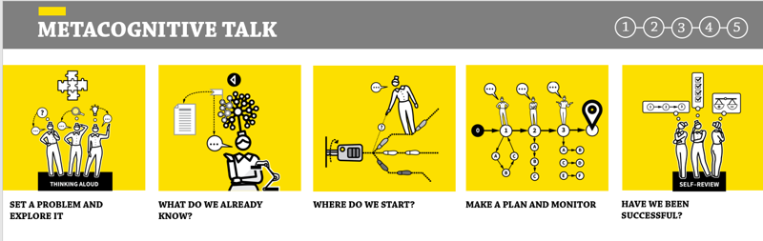
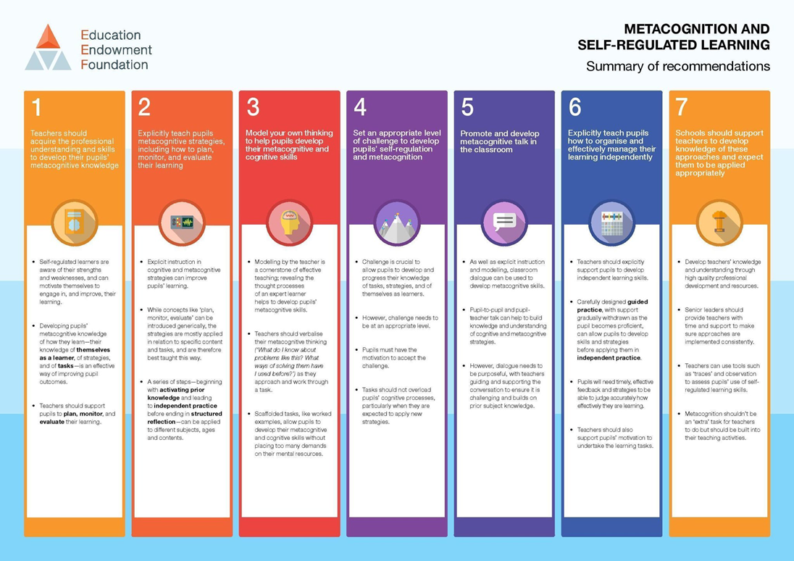

Slide 14
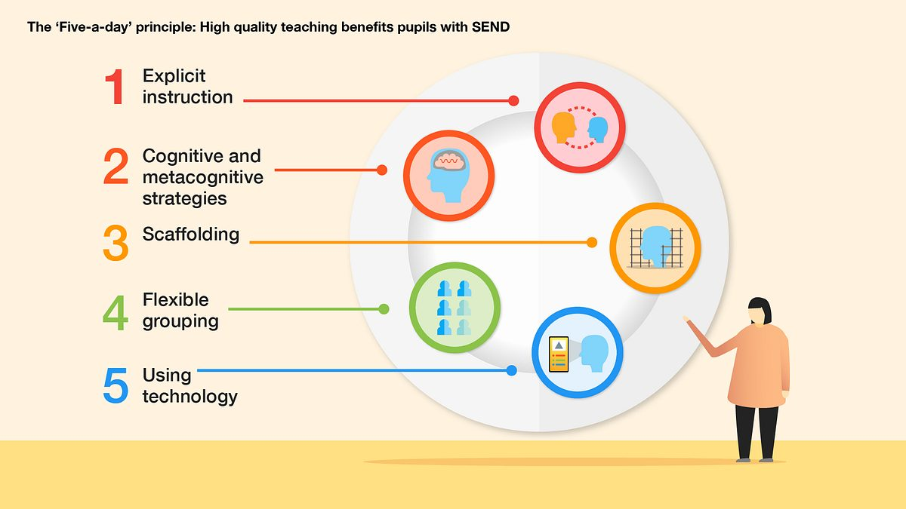
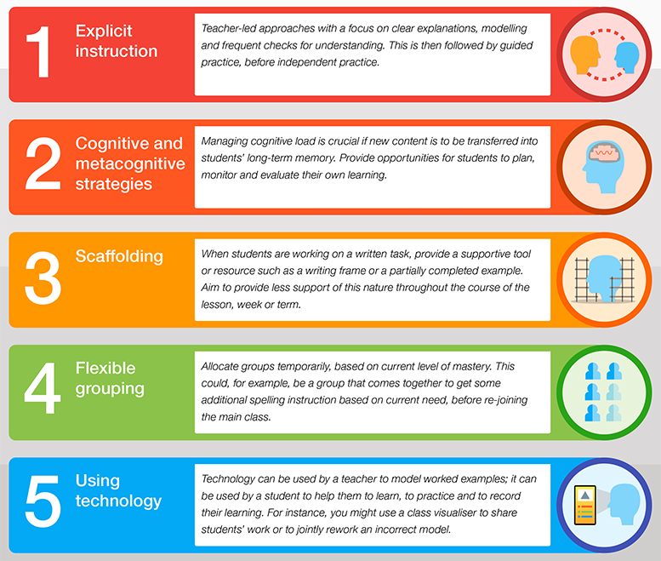

Slide 15
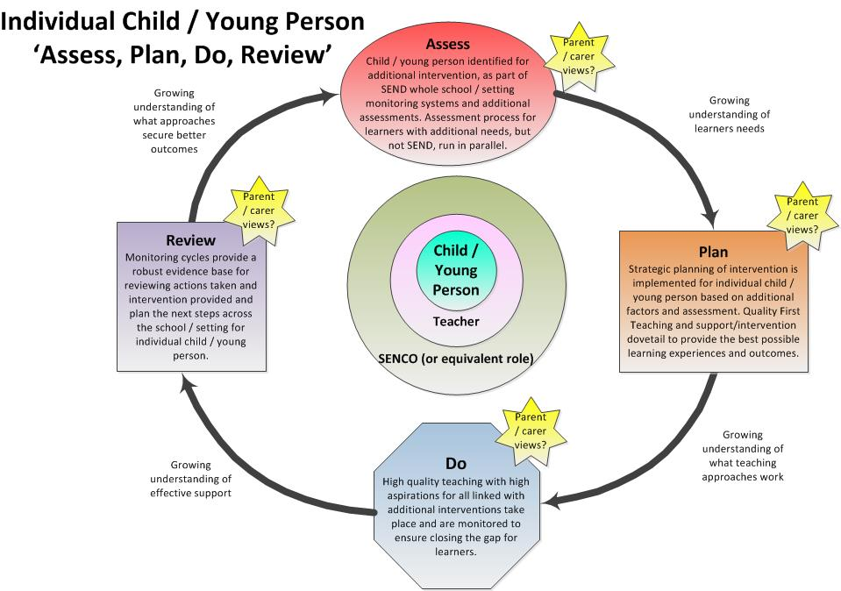

Slide 16
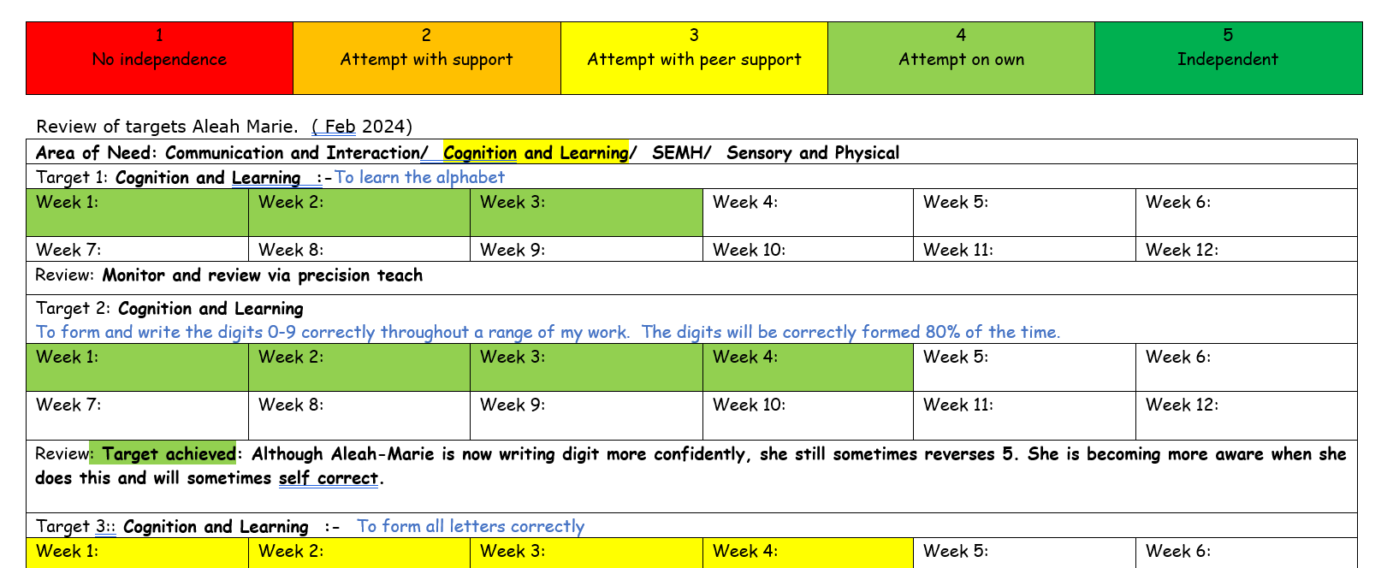

Slide 17
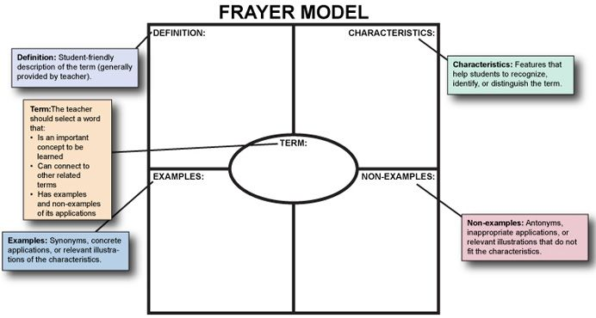
Vocabulary
We teach vocabulary explicitly, incidentally and through cultivating ‘word consciousness’ (Quigley 2021). Throughout our curriculum children will encounter carefully chosen subject specific vocabulary (often tier 2) in a variety of ways. Our planning explicitly states which vocabulary the children will be working on either in that lesson or over the course of the half-term.
In all lessons we are explicit with the vocabulary we are teaching, when children are introduced to new vocabulary. Words must be used in context and children are encouraged to explore the etymology (word history), morphology (word parts), word families, synonyms/antonyms and ways to remember the word or concept. Teachers use:
♦ The Frayer Model
♦ Play words games
♦ Use dictionary and thesaurus
♦ Flashcards
♦ Practising new words in conversation
♦ ‘Word of the day’
We need children to have an understanding of the etymology and morphology as this will lead to children gaining a
deeper understating/grasp of spelling patterns and vocabulary.

Slide 18
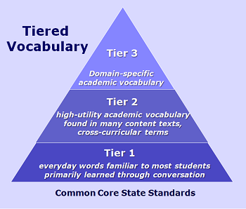

Vocabulary is the single most important form of background knowledge. To improve explicit and implicit vocabulary, high quality active practice is paramount e.g. word in context, using examples/non-examples. Teachers need to anticipate where children may struggle and give the children opportunities to rehearse, explore and learn definitions.

Slide 19
L.O. To estimate area (counting squares)
Area
The area of a shape is how much surface it has.
Length
The length is the measurement along a line.
Width
The width is the distance from one side to another, usually the shorter side.
Non-rectilinear shape
2D shapes that does not have straight lines.

Slide 20
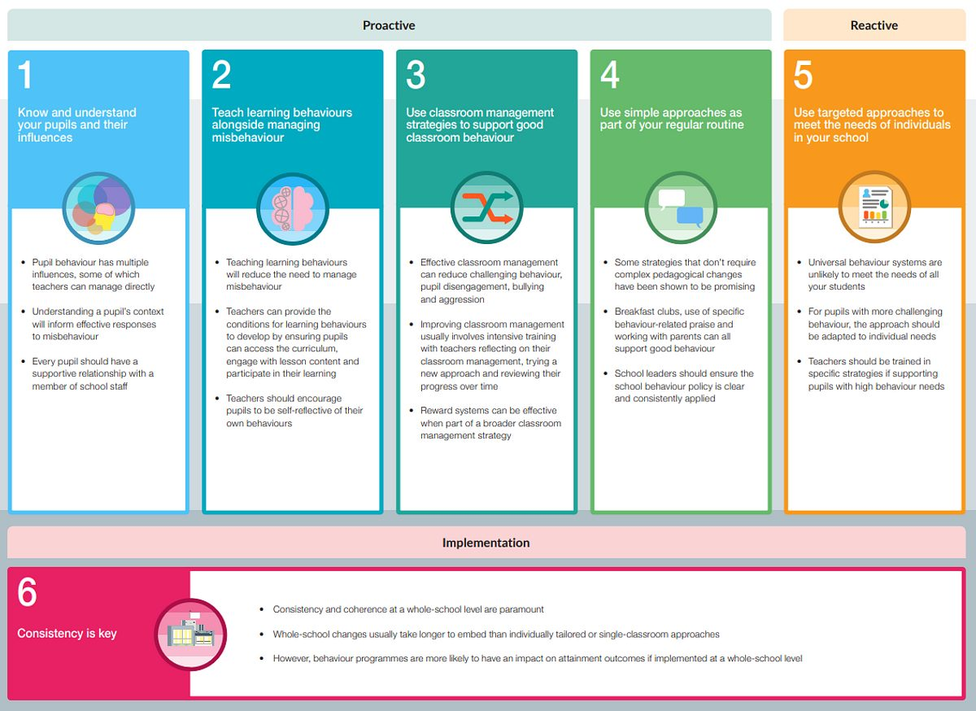
Behaviour
Firstly, it is imperative that every member of staff reads our Behaviour Policy. It is the expectation that all children will have a positive attitude towards their learning and towards every member of the school community. If a child does something ‘right’ an adult must ensure the children knows exactly what they are being praised for. Alternatively, if a child does something deemed ‘wrong’ then the children needs to know exactly what they did, so it does not happen again.
We do not have a one size fits all strategy for behaviour in each class. Each class teacher uses their knowledge of their class and their professional judgement e.g. behaviour boards, catch me being good, rockets, Premier League.
It is essential that the ‘little things’ are challenged to ensure the children are aware of the expectations. Good behaviour has always been a major contributing factor when it comes to learning. Behaviour interventions have a quantifiable impact on children’s progress (Hattie; EEF). The EEF Behaviour in Schools Guidance report (2019—above), highlights six recommendations to develop positive learning behaviour. Preventing poor behaviour is very powerful!

Slide 21

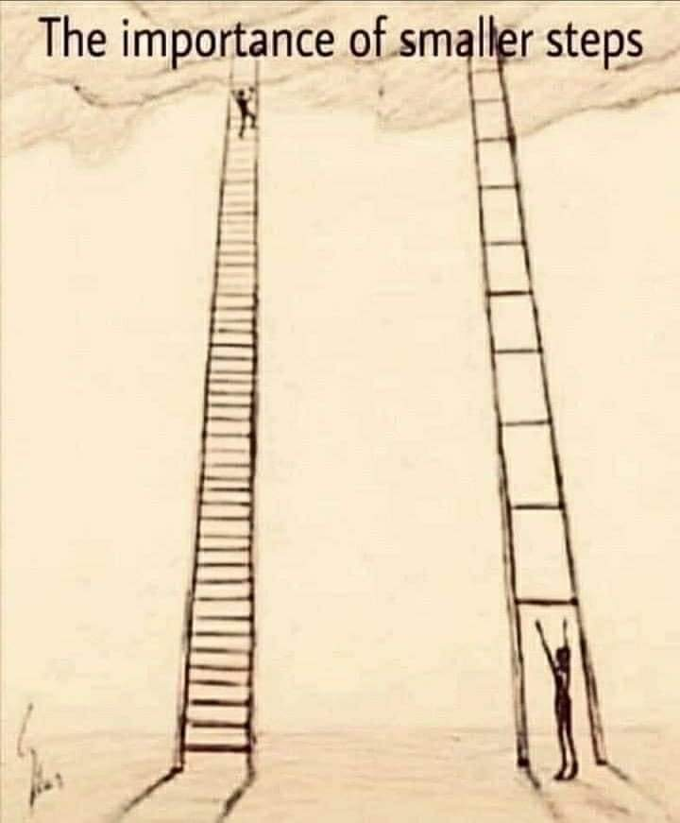

Questioning and Feedback
More effective teachers ask more questions to more people, in a probing style, including process questions. They check for understanding! The aim of this is partly to receive feedback as the teacher as to how well the learning process is going in order to adapt and respond. Asking, “Henry, tell me what you have understood”, is a lot more effective than asking the whole class, “Have you understood?”
Effective questioning is key for teachers to enhance explanation or modelling, check the recall of fundamentals as well as encourage the children to think more creatively, develop a deeper understanding. An effective teacher uses questions to extended a child’s understanding! It is paramount that children are encouraged to ask questions, so developing a culture where this is encouraged is a priority for teachers. Any productive learning environment allows questioning as this as it will stimulate deeper thinking and discussion. There are questions which are procedural, review and encourage critical thinking.
Too many teachers just rely on the same few children, normally more able, to answer questions...every child should be ready to answer questions and this may take time to establish as some children will be shy, self-conscious or anxious. It is imperative that the teacher establishes a learning environment where every child’s answer is respected. Children need to be active rather than passive learners, which can be established through various ways:
Model and explain how to answer questions/your thinking
Give children opportunities to rehearse their answers with their peers (Think, Pair, Share)
Show me boards
Say it again...better
Probing questions
What is the connection between X and Y?
Is there another example?
What are the main reasons?
Is there another way of explain this?
Build in thinking time
Stretch the answer by exploring different answers
Encourage children to recall prior knowledge, make connections between aspects of the curriculum or apply ideas to different situations.

Slide 22


Slide 23

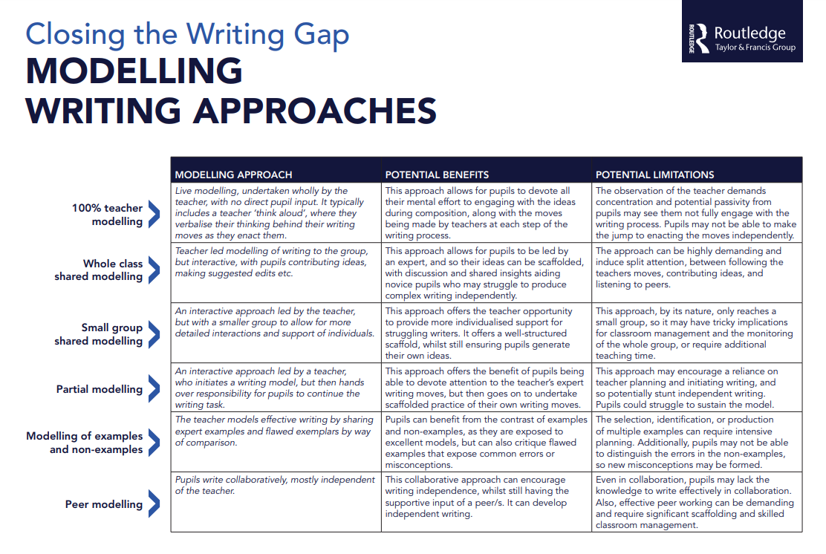
Live modelling (think aloud and model steps) is key to develop children’s awareness of what you are looking for. Evidence has shown that modelling and showing how your ‘learning journey’ (e.g. solving a problem, writing a paragraph) is vital to sharing with the children how to reach their destination. Show don’t tell! Let the children hear you thinking aloud! Sharing with the children your thought process, how to think things through and why you made a certain decision, helps children develop. Lemov calls this, ‘narrating the steps’.
Alternatively, you could select a child’s piece of work (with their permission) and use targeted questioning to receive feedback as this will help the child to self-reflect and improve the work they produce.
Children must consider the genre, audience and purpose.
‘Hunt not Fish’
Actively observing your class is essential! You should:
• be consistently deliberately scanning the room
• plan how you are going to circulate the classroom
• ensure you provide live feedback to scaffold support
• promote positive attitudes towards learning

Slide 24

Gain knowledge from your ‘active’ observations to assess what children understand/do not understand, common misconceptions, unplanned misconceptions, GPS errors.
Responding to all of the above through:
• Whole class feedback
• Live modelling
• ‘Show me’ with whiteboards
• Cold call and probe
• Use elaboration
Through this, you would have identified any gaps in knowledge and challenged straight away. Children will have a better understanding and are in a better position to move on.
The expectation at Slindon CofE Primary School, is that live modelling happens as often as possible. Do not be afraid to make mistakes as this will be a learning opportunity for all children.
The Importance of Talk – high quality talk and language-rich environment are fundamental to developing literacy. The quality of interactions between adults and children affects their vocabulary acquisition and cognitive development. Developing children's’ spoken language is integral to all aspects of our curriculum, so the children can articulate their understanding, develop their knowledge and build the vocabulary they need to support their learning.
Partner Talk – Children benefit from being taught how to talk to a partner, speaking in complete sentences and taking turns as appropriate. Children should be taught to speak to each other in sentences and to listen to each others’ ideas.
Thriving on Repetition – By re-reading stories to children, teachers can deepen the children’s familiarity with a story and increase their emotional engagement. Re-reading allows children to hear new vocabulary over again, which helps them commit the meaning of new words to their long-term memory. In addition, children have the opportunities to connect with characters, their feelings and to relive the excitement and emotion of stories.
Book corners – Each class should have well presented book areas, which is constantly changed, with different books promoted. Ideally, in key stage two children will be given the responsibility of updating the book corner. Focus should be on engaging the children into reading.

Slide 25
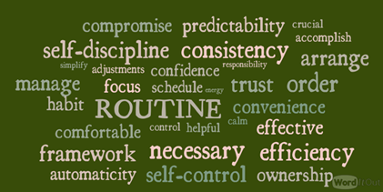

The importance of Routines
Engaging children into routines, help preserve thinking and working memory. Routines encourage participation, develop efficiency and an urgency to the child’s work. Daily routines and regular tasks helps cognitive function as well as help children be more creative. Routines, if used correctly, helps build positive learning behaviours, encourage children to be more independent and responsibility of their learning, smoother transitions between activities and can improve outcomes e.g. a routine can simplify a more complex learning environment as it informs the child exactly what to expect, what is expected of them and what is acceptable. (Burden 2003)
Routines are most powerful when:
• Chosen carefully
• Taught explicitly
• Repeated regularly
• Introduced gradually
• Reviewed and refined at regular intervals
Investing time and effort in well-established routines will bring a range of benefits. It will make our behaviour management more inclusive and, as the report also says, ​“To a great extent, good teaching for pupils with SEND is good teaching for all.” It will also have a marked impact on learning and on teacher wellbeing. (Diaz 2021)

Slide 26

Our mathematics planning is adapted from the White Rose scheme of work and the teaching is based on the NCETM mastery approach.
This incorporates:
• Retrieval practice based on previous learning.
• Introducing or revisiting key mathematical vocabulary during every lesson (I say; You say; We all say).
All maths work needs marking to identify next steps, misconceptions etc.
In addition, every lesson should include:
• Opportunities for the children to develop their fluency, reasoning and problem-solving skills.
• Children are encouraged to use manipulatives across the whole school, however older children will do this more independently.
All PowerPoints have a yellow background.

Slide 27
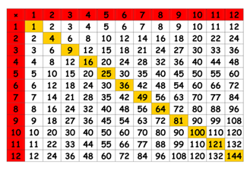
Our aim is for all children to develop a deep and lasting understanding of mathematical procedures and concepts. Coherence, representation and structure, mathematical thinking, fluency and variation underpin the teaching of maths mastery.
Our lessons comprise of key vocabulary, ‘ping pong’ focusing on key aspects of the learning objective and then children work independently consolidating the learning. Practice is an important element of learning, which should focus on reinforcing the child’s procedural fluency and develops their conceptual understanding.
It is essential that times tables is taught where the children are encouraged to identify patterns and not just focus on procedural fluency, but also incorporate conceptual fluency. Automaticity in learning multiplication tables and addition facts are essential to enable pupils to focus on new concepts. In addition, learning times tables reduces cognitive load, improves procedural and conceptual fluency.

Slide 28


Reading is fundamental to a child’s progress and we strive to empower our children to become lifelong readers. Our ultimate aim is to foster a love of reading, which we do by sharing a multitude of books/genres with our children, listening to them read, ensuring reading is a transferable skill (reading across the wider curriculum) and provide plenty of opportunities to read for pleasure.
Within school, we use phonics books to ensure that the children are able to practice the sounds they have learnt. Within the end of year 2 and KS2, the children also have access to a range of levelled books and Reading with the Lightning Squad. We also have ‘love to read’ books, which are books that the children can choose to read to develop their love of reading.
Teachers should actively engage with the children in choosing books to read. Give opportunities for children to share what they are reading to their peers as this may enthuse other children. For 20 minutes per week, children will have the opportunity to discuss their book and share why their chosen book would be good to read and/or write a brief review. The teacher also have access to Literacy Shed to support the teaching of core comprehension skills.
Spelling, Punctuation and Grammar are taught daily throughout the school. We use Spelling Shed for spelling and our long-term curriculum map to ensure progression and coverage.
The teachers are expected to teach the children new spellings weekly with a focus on the spelling rule/pattern, learning the meanings of the words in context.

Slide 29

Our phonics scheme is Phonics Shed (Phonics Shed - Phonics Shed) and the children in Catkins and Hazel have a lesson every day. In addition to this, every child in Catkin and Hazel will read with an adult at least once per week. Our English curriculum must have an even balance between reading and writing. We develop the children’s fluency, comprehension skills, vocabulary and ability to engage with increasing complex tests. The expectation is that:
individual records for each child are kept to monitor progress (using Phonics Assessment Data) and to identify children who need support
by the start of the summer term, children in Catkin Class will have at least 50 minutes (split) of phonics teaching; in Hazel Class the children will have at least 1 hour (split) of phonics teaching
When teaching, be clear about objectives for any session and make sure that the children understand them (e.g. ‘By the end of this week you will all be able to read these sounds; today we are learning the first one.’)
expect all children to participate throughout phonics sessions, for example by using ‘call and response’
make the most of the for teaching and use activities that maximise the number of words children read and spell
make sure that children practise using the knowledge they have been taught in previous lessons until they can use it automatically, thus freeing up their capacity to learn new knowledge (retrieval)
support the children to connect the new knowledge with their previous learning
demonstrate new learning in bite-sized chunks
ensure children are given opportunities to apply what they have learnt
praise the children for working hard and paying attention, being specific about what they have done well
use assessment to determine next steps clearly, including identifying children who might need immediate extra support.

Slide 30

Writing—Our aim is for every child to be a writer, with the ability to express themselves. Year one to year six will write an extended piece of writing at least once every three weeks. Teachers use a range of stimuli to engage our children. We have found that if a child is fully engaged in the process, which inspires writing and outcomes are improved e.g. after a school trip, a science experiment, enchanted by a book, an artefact, a community project, play.
Children MUST:
be shown by the teacher modelling writing and the thought process
see effective exemplars and discuss why they are effective
know the success criteria and why these are the success criteria
know the writing goals—who is going to view the writing when it is published or performed?
develop an understanding of their ‘writing toolkit’ practise skills and grammatical structures to the genre of writing
plan, draft, revise, edit and publish
practise their handwriting to ensure they have an efficient and fluent handwriting style.
Planning for reading, writing and spelling uses the pro-forma specified by the English subject leader.

Slide 31
Writing—Our English curriculum is developed around a sequence of high quality age-appropriate texts, using Literacy Count’s Ready Steady Write units of learning. We use each book to create opportunities to:
• develop grammar and punctuation knowledge and understanding to use and apply across the wider curriculum, through sentence accuracy sessions;
• explore the Writing structure and features of different genres, identifying the purpose and audience;
• plan and write an initial piece of Writing with a clear context and purpose before evaluating the effectiveness of Writing by editing and redrafting.
Building on this foundation, we teach literacy using a range of strategies which include:
• Group Discussion – Children discuss and interrogate new ideas in a small group or whole class setting. They listen to and value each other’s ideas whilst taking on board feedback so as to improve their own explanations.
• Partner Talk – Children work in partners to discuss their ideas. They are able to explain their ideas about texts they have read and prepare their ideas before they write.
• Questioning – Teachers use a range of questioning strategies to establish children’s current understanding and develop their learning.
• Modelled Writing – Teachers model Writing and editing to demonstrate the high expectations they have. They verbally ‘think aloud’ in order to make the Writing process explicit and provide a rich and varied vocabulary for the children to utilise in their own work. This happens daily, through sentence accuracy
• Shared Writing – Teachers use the ideas from the children to create shared pieces of Writing. This enables the children to see the Writing process in action as well as having pride and ownership over the finished piece.
• Editing – All children are signposted to regular opportunities for reviewing and editing their own and the work of others.
• Working walls – Teachers and children regularly update working walls to ensure learning is documented within a unit of work.
Class teachers ensure that the Writing process is clearly evident on working walls, with modelled examples being available to all pupils as the sequence of lessons develops.

Slide 32

Science
Science lessons at Slindon CofE Primary School aim to give all children opportunities to widen their understanding of science. Lessons will enable children to explore the world around them through a practical, hands-on approach. Designed to challenge and engage children, whilst they acquire knowledge as well as skills to help them work scientifically. Each working scientifically strand is carefully woven into diverse and inclusive lessons, which strive to support children in each curriculum area, providing rich opportunities for future careers in the scientific field.
At Slindon CofE Primary School, progression is key, and it is through a spiralling curriculum that children are able to build on their prior knowledge and expand on their understanding through revisiting previously taught topics. Topics such as plants, are taught to children in KS1 and built upon as children make their way through the school.
Our aim is for children to leave Slindon CofE Primary School at the end of year 6, with a positive and enthusiastic working attitude towards science, with a wide range of scientific vocabulary and an embedded understanding of what it means to work scientifically. As our world is ever evolving and rapidly changing, it has never been more evident that the children of this generation need to be equipped with the knowledge and understanding to go forth and build a better future.
We use our own planning and supplement this with activities and resources from White Rose Science.
It is imperative that we use our outdoor area to develop a love of science in our children e.g. nature garden, Forest School.

Slide 33

Religious Education
For the majority of Religious Education planning we use the Emmanuel Project—this planning cannot be just picked up and taught. You must ensure each lesson has each of these core concepts and is a balance of theology, social science and philosophy. The teacher chooses how to weave together the elements in order to achieve the outcomes.
This curriculum is taught over two years and aims to build year on year.
Through our Religious Education curriculum we aim:
♦ to engage children in enquiring into and exploring questions arising from the study of religion and belief, so as to promote their personal, spiritual, moral, social and cultural development.
♦ to provide children with knowledge and understanding of Christianity and other principal religious traditions and beliefs represented in the United Kingdom.
♦ to develop children’s understanding of the ways in which beliefs influence people in their behaviour, practices and outlook.
♦ to enable children to apply the insights of the principal religious traditions to their own search for identity and significance.
♦ to enable children to become aware of their own beliefs and values and to have a positive attitude to the search for meaning and purpose in life.
♦ to encourage learners to develop a positive attitude towards other people who hold religious beliefs different from their own.

Slide 34

Foundation Subjects Planning
It is the teachers and the subject leads responsibility to ensure the National Curriculum has been covered by our curriculum planning. Our aim is to get all of our foundation planning the same format as in appendix 1 and appendix 2. All of our planning must be based on prior knowledge/learning and incorporate retrieval practice opportunities, to ensure the children have activities to embed their knowledge into their long term memory. Much of the planning is based around an overarching question e.g. Where in the World?, What is Trinity?
Art and Design: Our curriculum links closely to our half-termly themes. Our curriculum is skills based, so documenting the ‘journey’ is more important than the outcome. Every year group explores specified artists. Art units should follow a clear progression of skills and work should be of high quality.
From Year one up, children have sketch books. These should be used to document the creative process, plan work and as an outlet for creativity. Teachers should take photographs as evidence of children’s work, although originals can be displayed and then sent home. Digital copies are stored on the server and originals, if kept, can be stored in paper folders. Planning should be available on the server.
We use Access Art to support our art curriculum.

Slide 35

Computing: The whole school use the Teach Computing (https://teachcomputing.org/curriculum/) planning. We use the Oak National Academy to support our teaching of online safety.
Design and Technology: We use our own planning and have access to the unit outlines from Projects on a Page, a scheme designed by the D&T Association, to inform our planning for Design and Technology. We follow a long-term Plan across the school which ensures a progression of skills and coverage of the National Curriculum.
As a school, it is an expectation that each class will teach an element of food technology across the year.
​
Geography: Subject Lead planning across the school using template (Appendix 2)​
​
History: Subject Lead planning across the school using template (Appendix 3); each unit will cover at least two of the school’s agreed core concepts (invasion, settlements, civilisations, empire, technological advancements and cultural change). ​
​
Languages (French): our French lessons are taught by Mrs Soal and are only in KS2.

Slide 36
Music: The whole-school use the Charanga Music Curriculum and planning from the RBO. Teachers across the school use the whole scheme.
Physical Education: Our Physical Education curriculum is designed to develop children’s knowledge and understanding of how to live a healthy, active lifestyle, whilst enabling them to develop transferable skills that can be used across a range of different contexts, including sports and exercise.
There is an expectation to do the ‘Golden Mile’ at least three times a week and it can be at the start of the P.E. lesson (weather permitting).
RSHE: The expectations are:
Our teaching of RSHE is guided by E4S. Each class will have forty minutes of RSHE per week; lessons are taught by our RSHE lead.
This will follow the overview provided but will be tailored by the class teacher to best fit the cohort. Teachers should be able to provide feedback about the appropriateness of key questions and subject matter (for example there is little point teaching puberty in Year 6 if girls are starting their periods in Year 4 – these type of observations should be noted by the class teacher and shared with subject lead/SLT)
Planning should be available on the server and any "formal" work should be stored as appropriate to the class.

Slide 37
Pupil voice and examples of work.
Choose one lesson per unit, per subject and collect pupil voice.
Can be a post it with quotes about the learning, what they enjoyed.
Collect good examples of work and stick into the books.
Make sure the name and year group is on each piece.
Way for us to monitor what the pupils think and see their progress.

Slide 38

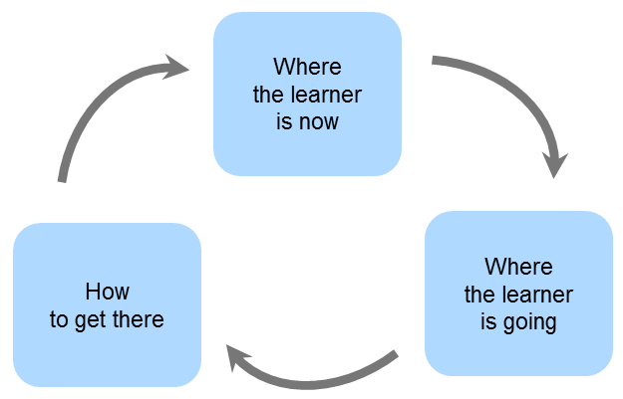
Assessment
Assessment for learning should happen in every lesson. Some lessons will be used to consolidate the children’s learning, however every lesson should have an opportunity for children to retrieve previously taught information and this can be used to assess children e.g. Flashback 4.
We currently use our knowledge organisers to show the knowledge the children are learning. These are assessed within lessons, using forms of formative and summative assessment. To assess the progression of skills over time, we use use progression sheets, created by subject leads, to track progress over time. As a school, are looking to move to Insight (https://www.insighttracking.com/) to track the children in all subjects in our curriculum.
Assessment is expected to be updated on a weekly basis and children should be assessed away from point of teaching e.g. teach fractions in week 3; children will be assessed in week 5. Any gaps/misconceptions would need to be addressed and planned for by the class teacher. Children will complete weekly times table challenges and spelling tests.
In addition, children completely termly ‘test week’ where the children in year two to year six complete reading and maths tests. In the summer term, year one also complete reading and maths tests. Every half-term, all children in key stage two complete online times table assessment.

Slide 39
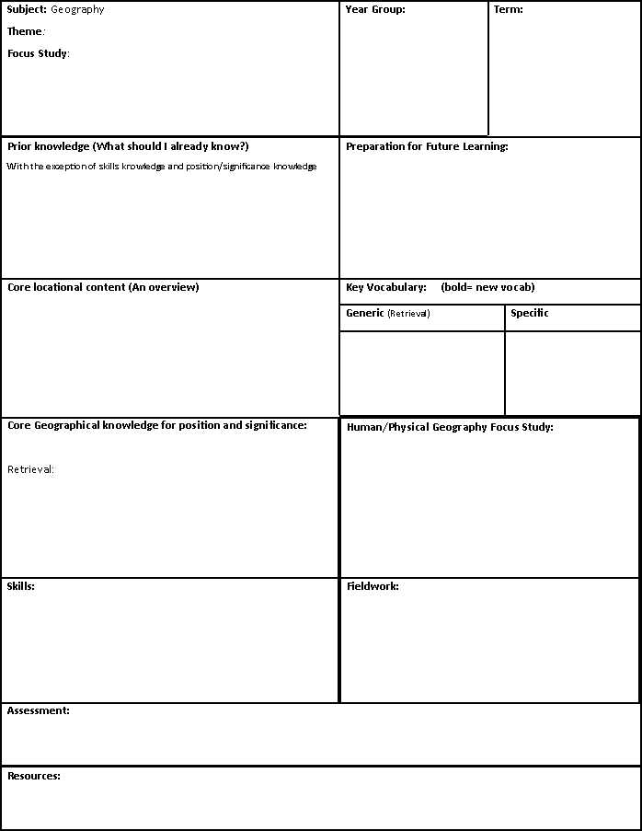
Appendix 1

Slide 40
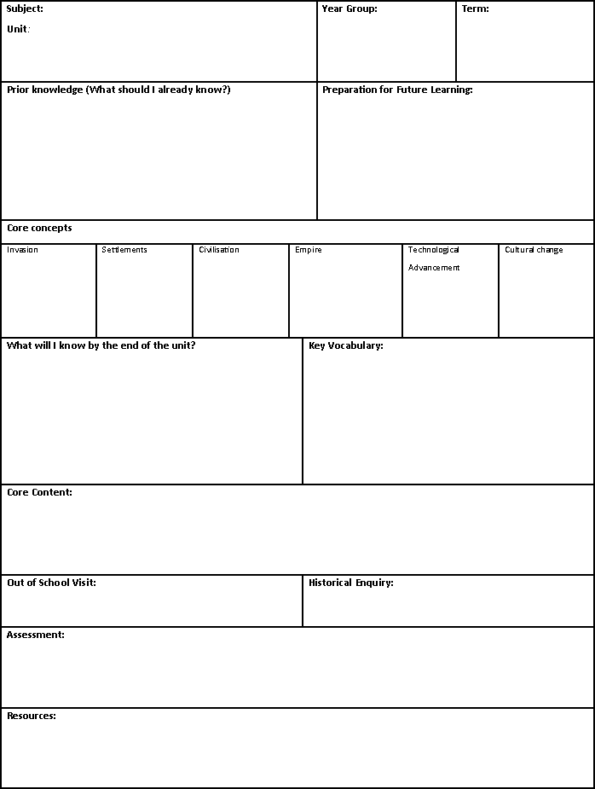
Appendix 2

