Slide 1
Slindon CofE Primary School
Maths calculation and reasoning.

Slide 2
Aims
To understand key aims of the national curriculum for maths.
To understand how we approach reasoning at Slindon.
To gain ideas around how you can support your children with learning maths at home.

Slide 3
Attitudes to maths
Our own feelings towards mathematics are influenced by:
our own parents’ attitudes towards the subject
our own experiences of the subject at school,
popular culture.
Jo Boaler British education author
“Ideas that students hold about their ability make a great difference to their learning ability.”

Slide 4
Carol Dweck
Fixed and growth mindsets
Fixed Mindset
Intelligence is static.
I must look clever!
Avoids challenges.
Gives up easily.
Sees effort as pointless.
Ignores useful criticism.
Growth Mindset
Intelligence is expandable.
I want to learn more!
Embraces challenges.
Persists in the face of setbacks.
Sees effort as the way forward.
Learns from criticism.
Likely to plateau early and achieve less than full potential.
Reaches even higher levels of achievement.

Slide 5
Moving from the concrete to the abstract.
For all of our calculation policies we start with the concrete.
We follow the CPA strategy (Concrete, Pictorial and Abstract).
In school we use a variety of apparatus to ensure the pupils gain a firm grasp of calculation,
These include:
- Numicon
- Dienes
- Counters
- Teddy bears
- Multi-link
- Anything we can use!

Slide 6
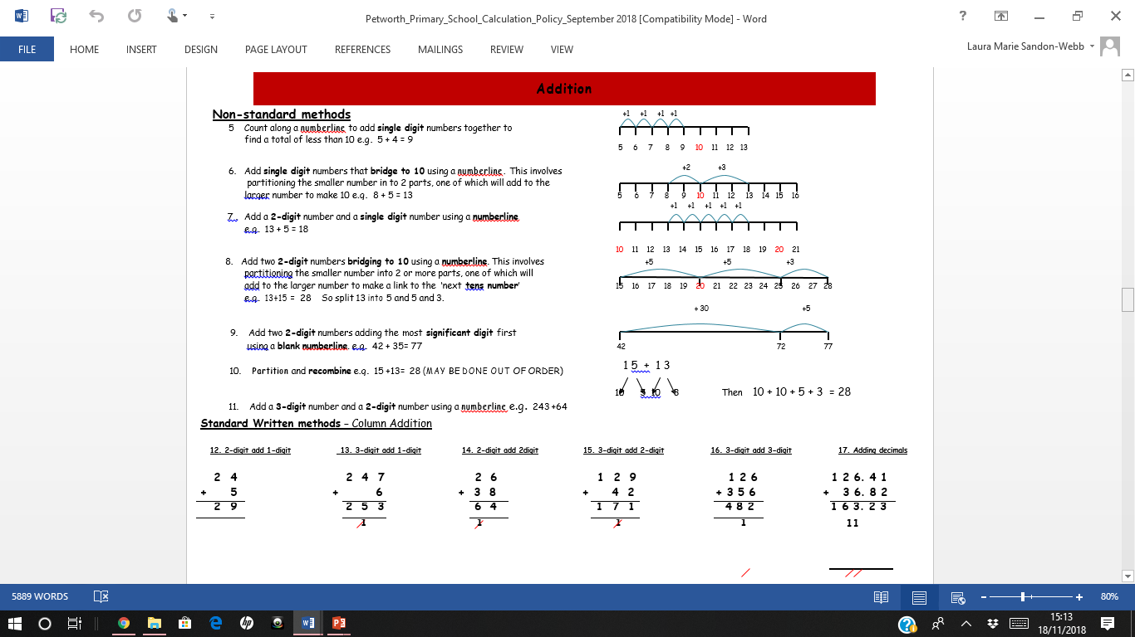

Slide 7
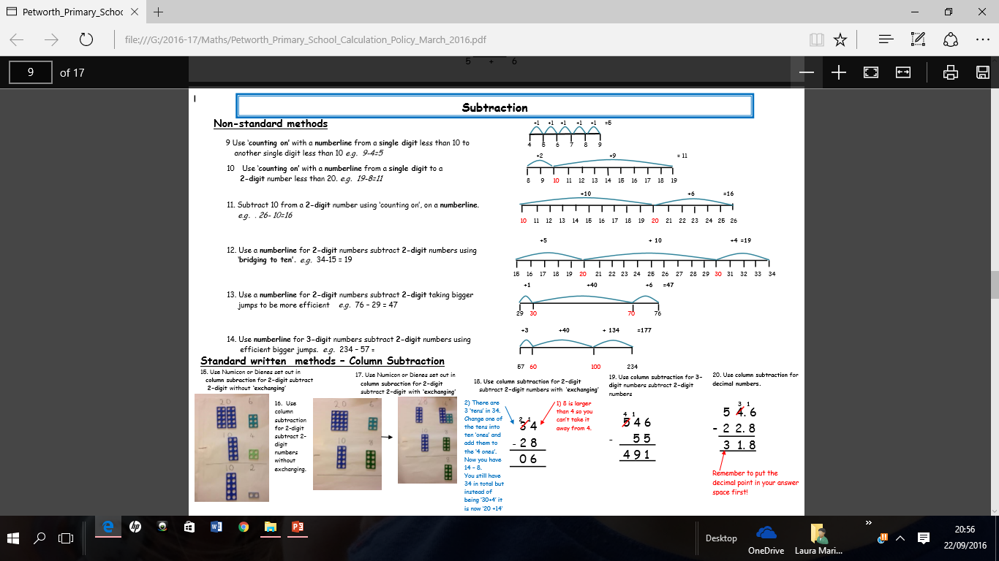

Slide 8
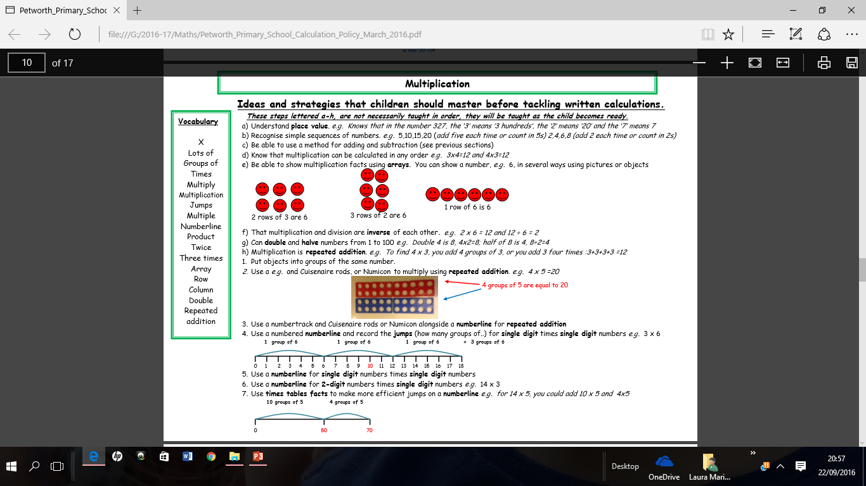

Slide 9
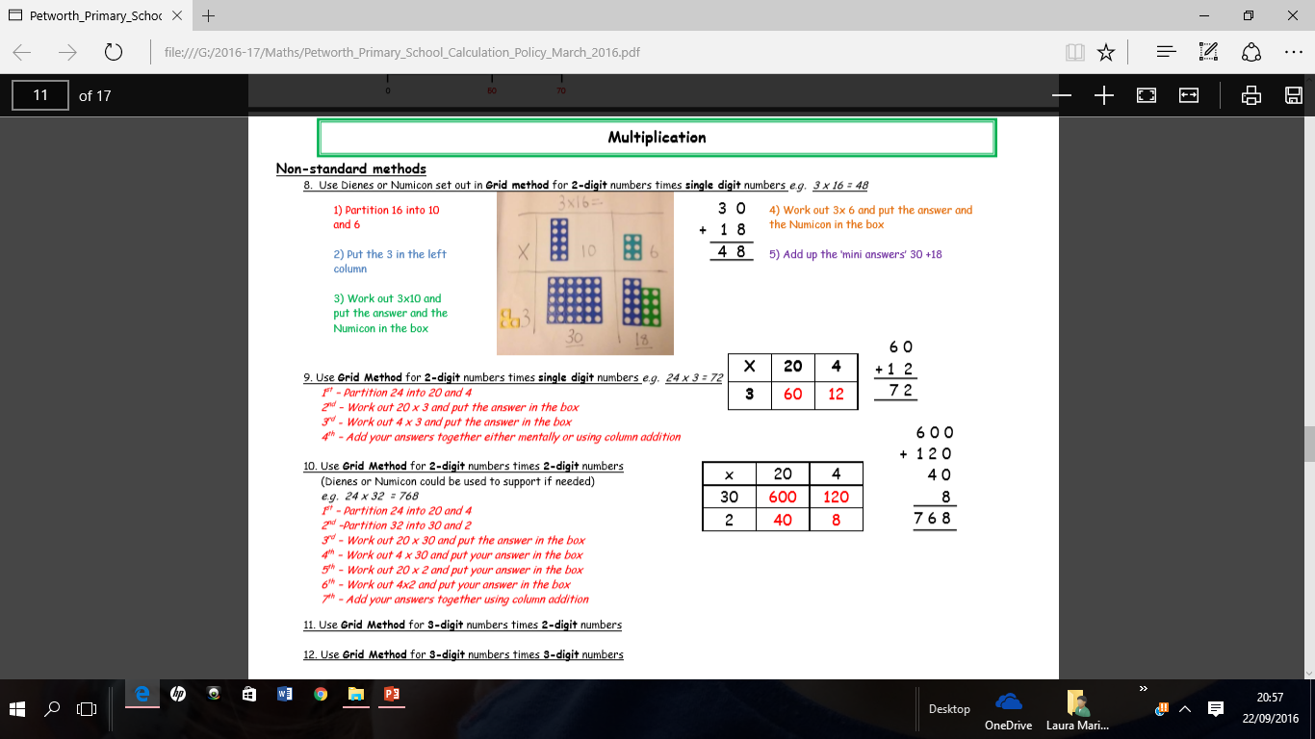

Slide 10
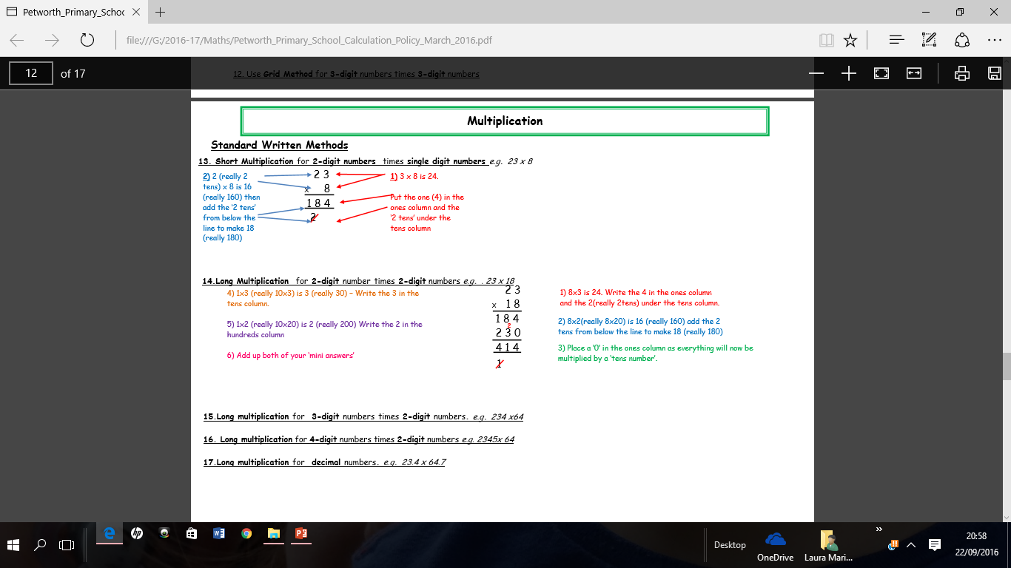

Slide 11
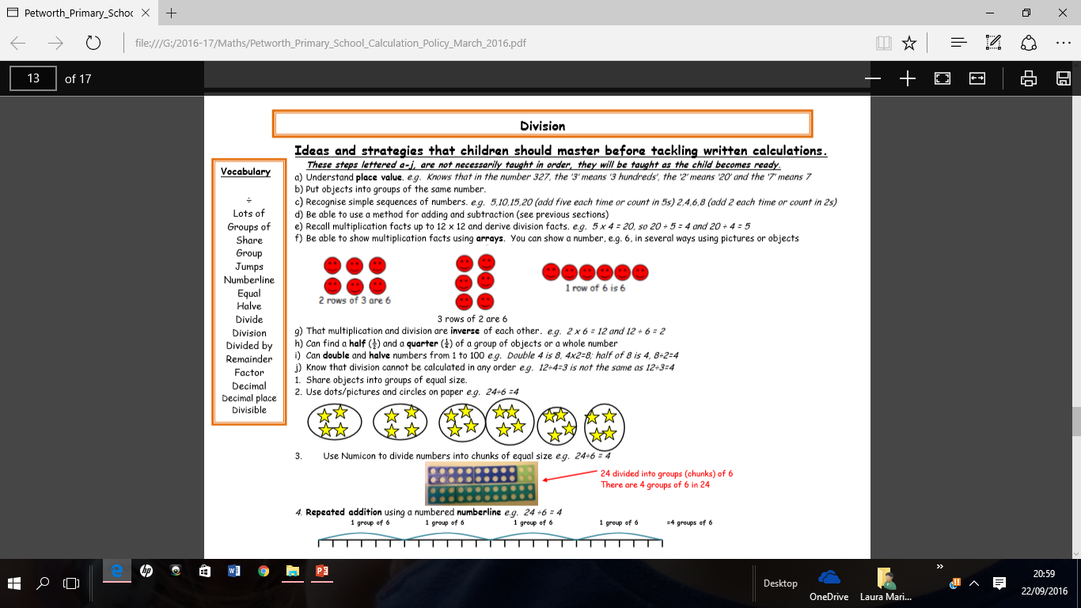

Slide 12
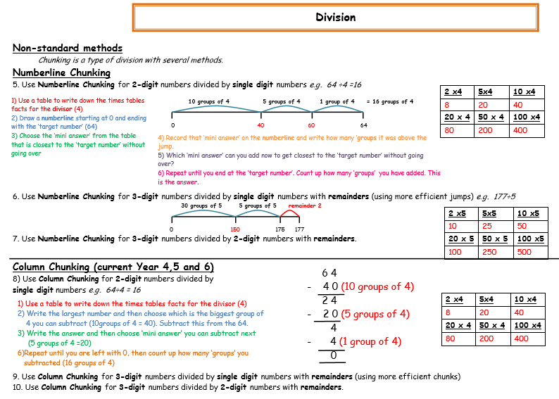

Slide 13
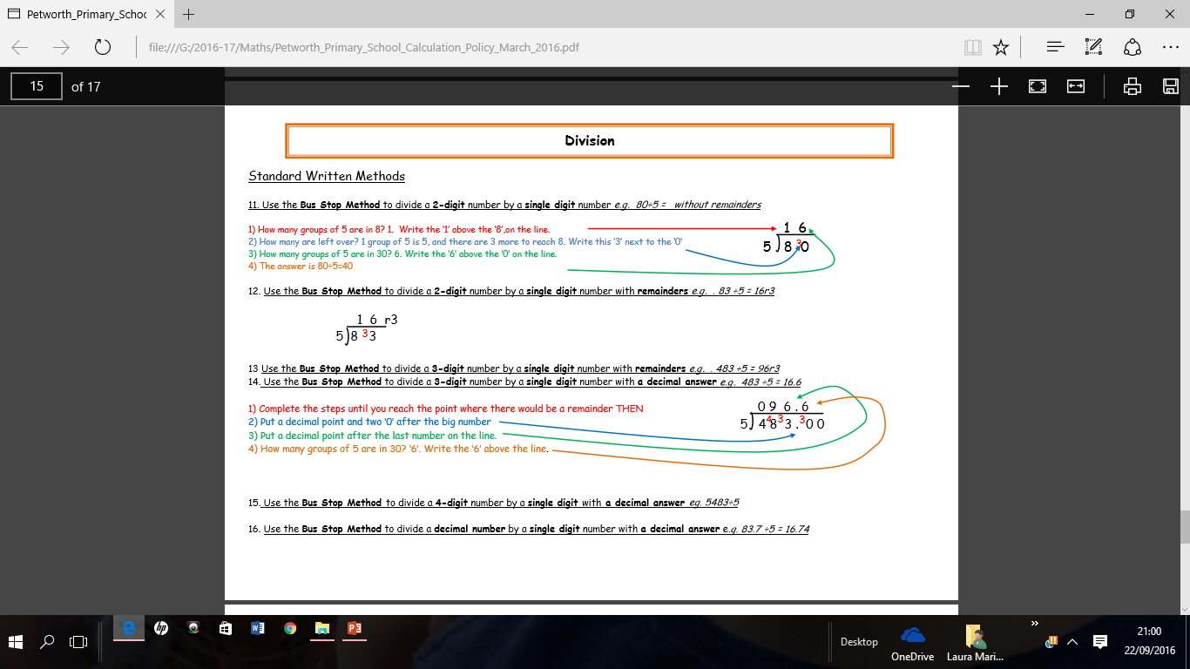

Slide 14
Why we do it?
By the end of each key stage we want the pupils to be ready:
1) To move on
2) To be ready for a world of mathematics.

Slide 15
Reasoning
Many pupils see reasoning as working with big numbers.
In fact… they can be small numbers, just in an unusual context.

Slide 16
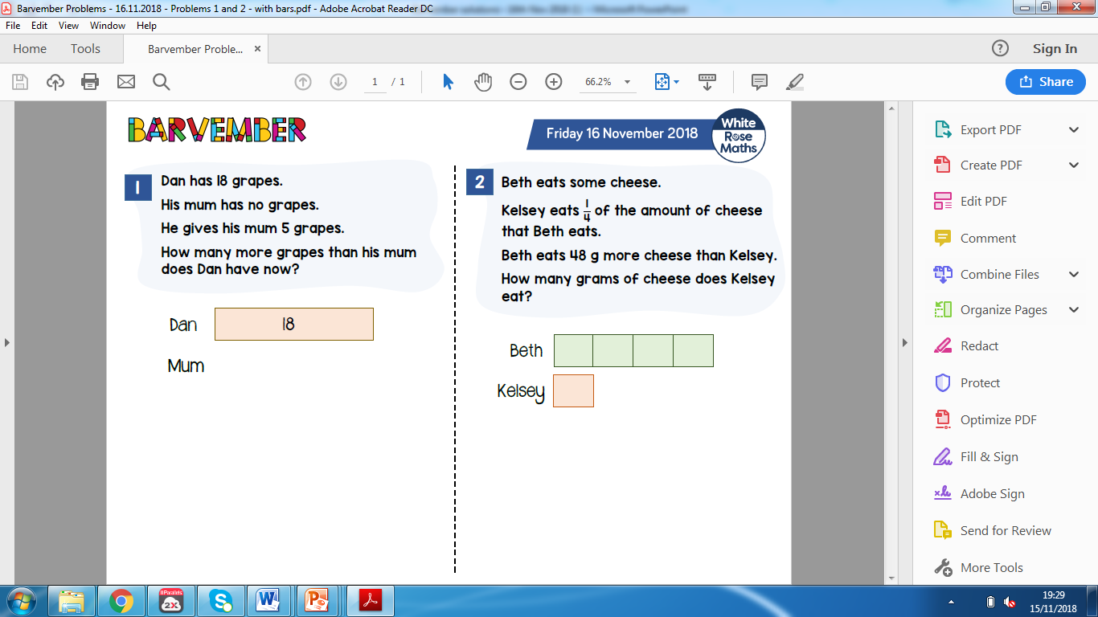
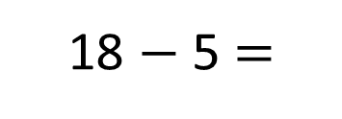
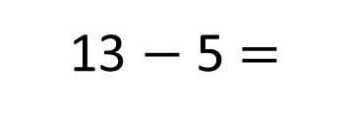
Model
Calculations
18 $−$ 5 $=$
13
Dan
13
18
5
13 $−$ 5 $=$
8
Dan’s Mum
5
8
?
8
Dan has _____ more grapes than his mum.

Slide 17
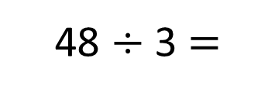
Model
Calculations
48 $÷$ 3 $=$
16
Beth
16g
16g
16g
16g
Kelsey
16g
48g
16g
?
16
Kelsey eats _____g of cheese.

Slide 18
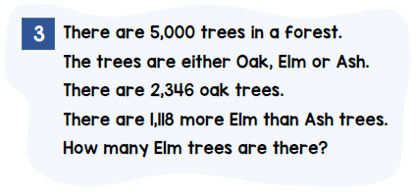
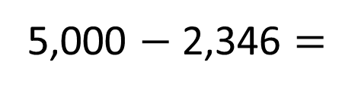
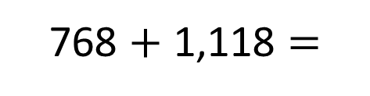
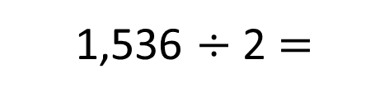
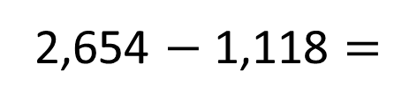
Model
Calculations
Oak
2,346
5,000 $−$ 2,346 $=$
2,654
?
1,886
2,654 $−$ 1,118 $=$
1,536
Elm
768
1,118
5,000
1,536 $÷$ 2 $=$
768
1,536
2,654
768 $+$ 1,118 $=$
1,886
Ash
768
1,118
1,886
There are _____ Elm trees.

Slide 19
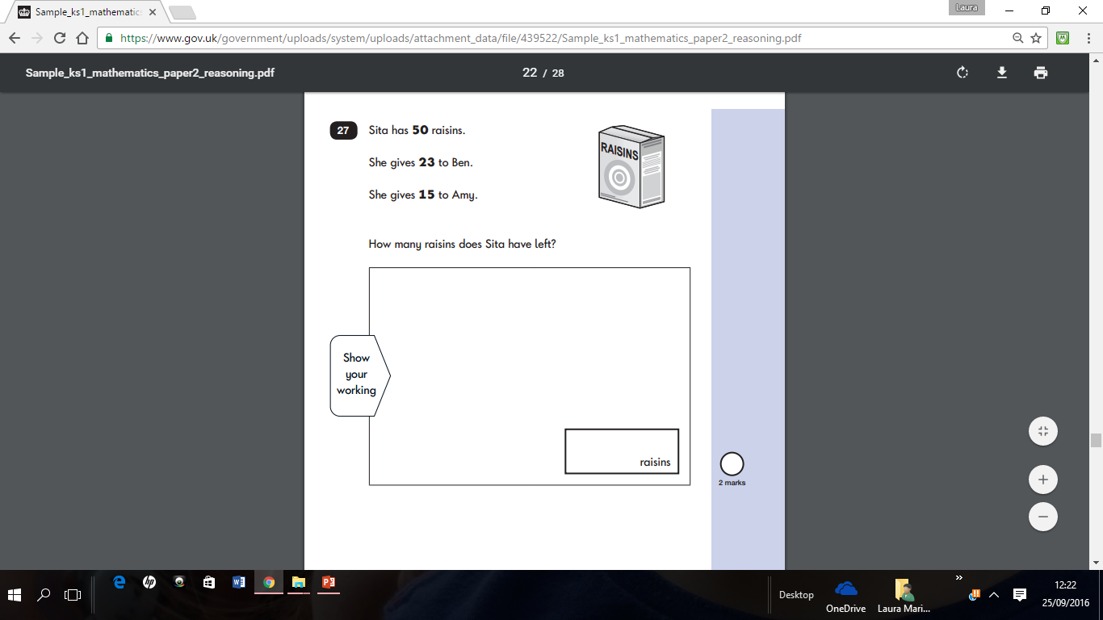
Reasoning
Year 2 Example:
50-23 = 27
27-15 = 12

Slide 20
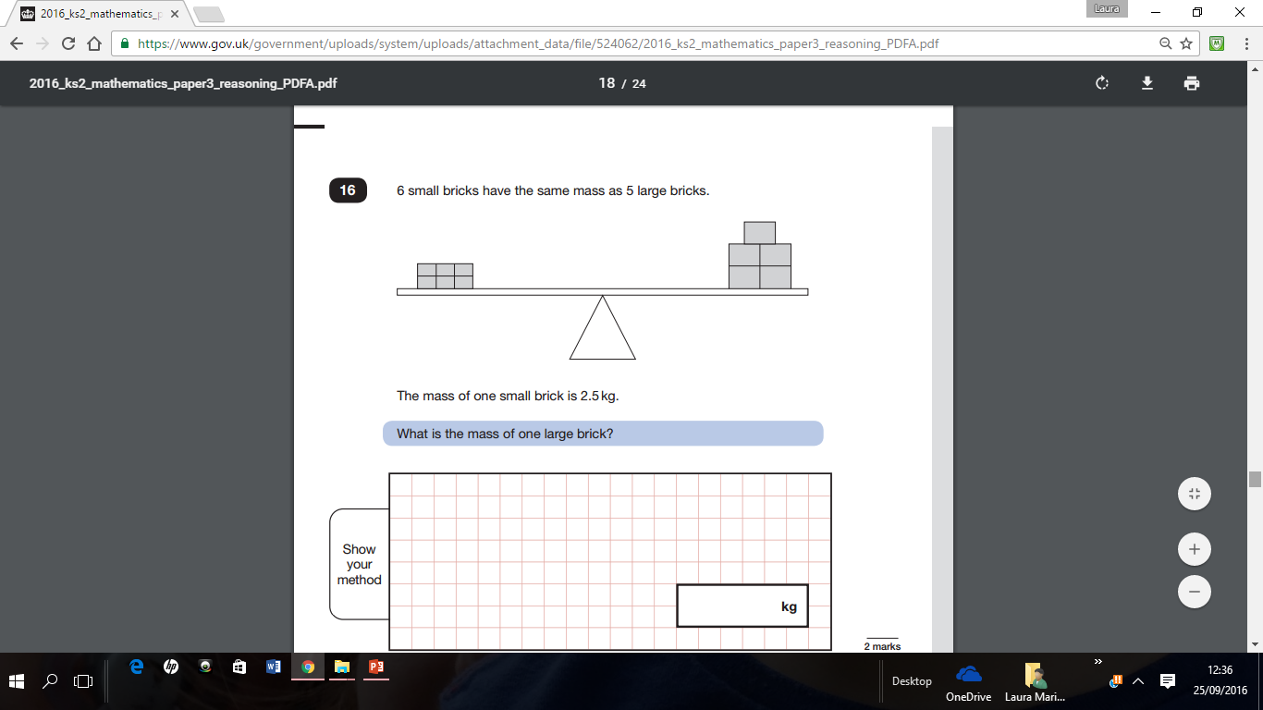
Reasoning
The weight of the piles of bricks is equal.
2.5 x 6 = 15kg
15 / 5 = 3kg
Each brick is 3kg
Year 6 example:

Slide 21
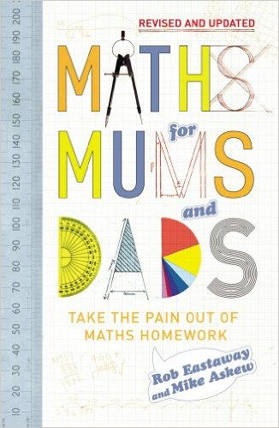
A recommendation…

Slide 22
Any questions?
We have some children, ready to show you some of the calculation strategies.
Many are working with number at the moment, so if you look in their books you should see a variety of methods being used.

