Slide 1

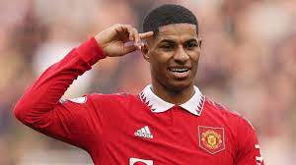
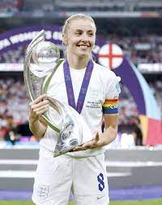
Chestnuts PSHE Knowledge Organiser
Autumn Term 1 – Physical Health and Wellbeing
In the Media
Key Vocabulary
Marketing | Promoting or selling a product.
Advertising | Draw attention to a product.
Media | The way to communicate with lots of people e.g. newspaper, radio, internet, TV
Celebrities | People who are well known or famous for what they do.
Role model | Someone who sets an example for other people to follow.
Influence | To change a person’s behaviour, attitude, beliefs.
Manipulation | To influence on purpose.
What we should know and what we should be able to do:
To learn that messages given on food adverts can be misleading
• I know that food and drink adverts can use misleading marketing messages in order to make a product seem more healthy for consumers • I am able to compare the health benefits of a food or drink product in comparison with an advertising campaign • I can identify advertising as one influence on peopleʼs choices about food and drink
To learn about role models
• I am able to analyse how the media portray celebrities • I recognise that celebrities can be presented as role models and that they may be a good or not-so good role model for young people • I can explain why we need to be cautious about things we see, hear or read about in the media
To learn about how the media can manipulate images and that these images may not reflect reality
• I understand that images can be changed or manipulated by the media and how this can differ from reality • I can describe how the media portrayal might affect peopleʼs feelings about themselves • I accept and respect that people have bodies that are different
Questions to think about …
Can you think of any marketing messages which can’t really be true?
Do you think advertising has ever persuaded you to buy something which you wouldn’t’ normally have bought?
Why is it important to think carefully about what we see, hear or read in the media? Can you think of any good role models? Any bad role models?

Slide 2
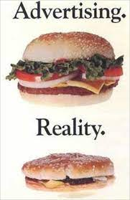
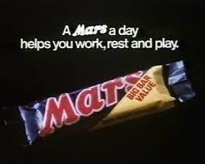
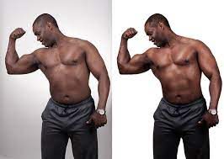
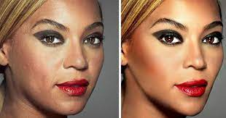
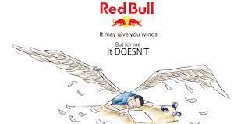
Chestnuts PSHE Knowledge Organiser
Autumn Term 1 – Physical Health and Wellbeing
In the Media
Manipulating images – before and after photoshop!
Children’s literature to support the topic
These books are really great to help us understand the issues we will cover in this unit of work, you can find some in our library
• Girls Under Pressure by Jacqueline Wilson
The Wizard and the Ugly Book of Shame by Pablo Bernasconi
Useful Websites:
Always talk to someone who helps keep you safe, such as a parent, teacher or other adult you trust.
Food a Fact of Life: www.foodafactoflife.org.uk (8-11 years) Change4Life: www.nhs.uk/change4life ChildLine: 0800 11 11 www.childline.org.uk Dove self-esteem project for girls: www.selfesteem.dove.co.uk Young Minds www.youngminds.org.uk

