Slide 1
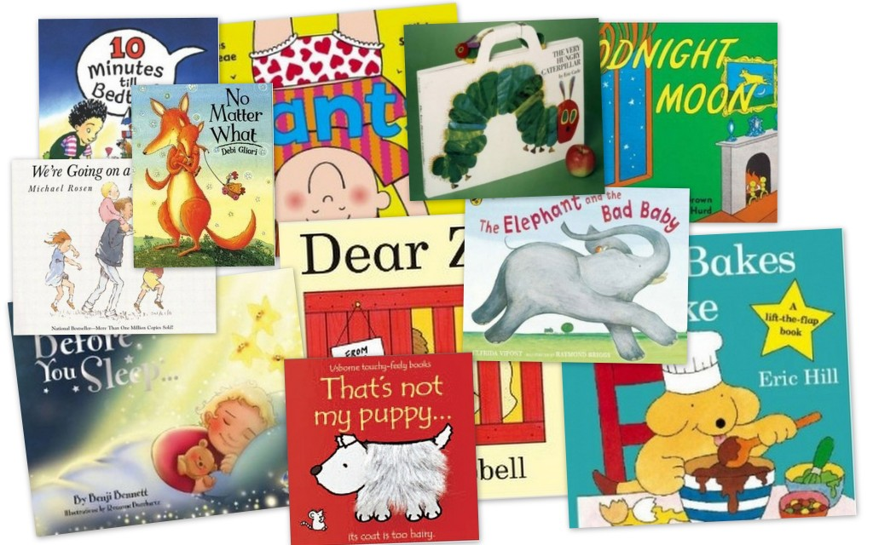

Reading workshops
Wednesday 8th November 2017

Slide 2
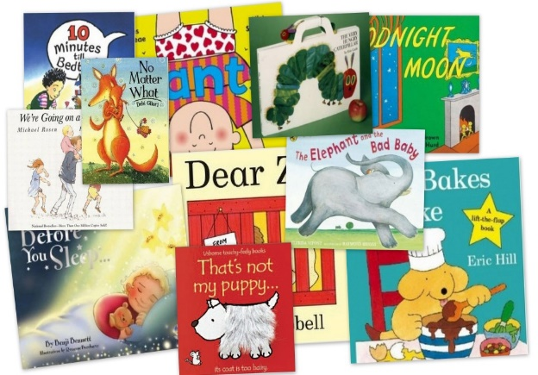
The Power of Reading!
Creating a love of reading in children is potentially one of the most powerful ways of impacting on academic standards in school.
There can be few better ways to improve pupils chances in school, or beyond in the wider world, than to enable them to become truly independent readers.
Reading is all about acquiring meaning; for
enjoyment, information and understanding.
Notes:
If children are happy to read, they are more likely to do so when they have to as well as when they want to.

Slide 3

Reading in School
The Teaching of Reading
The National Curriculum
“A high-quality education in English will teach pupils to speak and write fluently so that they can communicate their ideas and emotions to others and through their reading and listening, others can communicate with them.
Through reading in particular, pupils have a chance to develop culturally, emotionally, intellectually, socially and spiritually. Literature, especially, plays a key role in such development. Reading also enables pupils both to acquire knowledge and to build on what they already know.”
Notes:
Give a brief overview of the function of each of the above aspects of treading in school.
Explain that all of these are part of the teaching of reading.
Explain that sometimes, as parents, there is an expectation that children are heard reading often. This may be the case for some, but not all children. The hearing of reading is not the same as the teaching of reading.
Explain the school policy and expectations about home reading – in general. Details to follow,

Slide 4
Reading in School
The Teaching of Reading
Phonics
Shared reading
Whole class guided reading (VIPERS)
Independent reading
Focused reading activities
Reading across the curriculum
Class novels and stories
The hearing of reading is NOT the teaching of reading
Notes:
Give a brief overview of the function of each of the above aspects of treading in school.
Explain that all of these are part of the teaching of reading.
Explain that sometimes, as parents, there is an expectation that children are heard reading often. This may be the case for some, but not all children. The hearing of reading is not the same as the teaching of reading.
Explain the school policy and expectations about home reading – in general. Details to follow,

Slide 5
What is phonics?
Phonics is a way of teaching children how to read and write. It helps children hear, identify and use different sounds that distinguish one word from another in the English language.
Written language can be compared to a code, so knowing the sounds of individual letters and how those letters sound when they’re combined will help children decode words as they read.
Understanding phonics will also help children know which letters to use when they are writing words.

Slide 6
What is Phonics Shed?
Phonics Shed is the phonics programme used in school to teach your child how to read and write.
It includes daily 30-minute sessions to teach essential skills for reading and writing.
The Phonics Shed programme is narrative based, with lots of fun and engaging characters, songs and stories to help develop a love of reading and writing alongside the other basic skills it teaches.
It is split into four chapters and is mostly used from ages 3 to 7

Slide 7
Phonics shed
Your child will bring home books from our decodable reading scheme. These will usually be a paper back version.
It will have been carefully selected by your child’s teacher to go alongside the GPCs your child has been taught in school.
These books are for your child to read to you. It has been carefully chosen so that they can use the skills they have learnt in phonics to read all the words.

Slide 8
Phonics Shed
Some books will have words for you to read with your child, these are known as ‘share with me’ books.
Other books will have no words for the children to read but contain detailed pictures to discuss and create their own story.
Most books will have key words to practise before and suggested questions for you to ask about the story after they have read it – you can ask other questions too as those provided are just a guide!

Slide 9
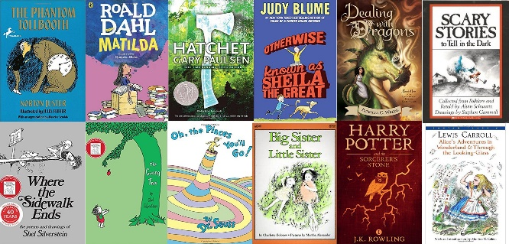
Understanding
(Comprehension)
Being able to read does not mean you understand what you read.
Your child might sound like a good reader but may not necessarily understand what the text means.
The best way to develop understanding is to talk about texts.
The next slide is easy to read – does anyone understand what it means?

Slide 10
An extract taken from a computer manual
According to the previous ATA/IDE hard drive transfer protocol, the signalling way to send data was in synchronous strobe mode by using the rising edge of the strobe signal. The faster strobe rate increases EMI, which cannot be eliminated by the standard 40-pin cable used by ATA and ultra ATA.
Why is this harder for us to understand?
Notes:
This slide shows that the ability to read aloud well is no indication of understanding.
Reading comprehension has to be taught.
Language has to be taught, defined, used and understood.

Slide 11
Reading requires two skills
Phonics and Word Recognition
The ability to recognise words presented in and out of context.
The ability to blend letter sounds (phonemes) together to read words.
Understanding
The ability to understand the meaning of the words and sentences in a text.
The ability to understand the ideas, information and themes in a text.
If a child understands what they hear, they will understand the same information when they read.

Slide 12
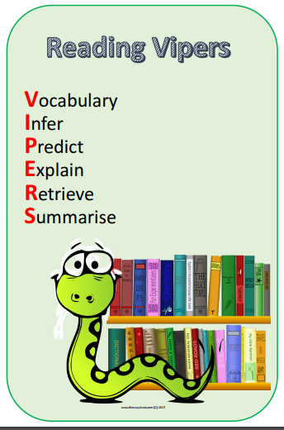
Whole School use of VIPERS to teach reading skills
Notes:
Look at the content domains – what might the letters stand for?

Slide 13
KS1 Year 1 & 2
VIPERS title | Content domain description
Vocabulary | draw on knowledge of vocabulary to understand texts
Infer | make inferences from the text
Predict | predict what might happen on the basis of what has been read so far
Explain | identify / explain key aspects of fiction and non-fiction texts, such as characters, events, titles and information
Retrieve | identify / explain key aspects of fiction and non-fiction texts, such as characters, events, titles and information
Sequence | identify and explain the sequence of events in texts

Slide 14
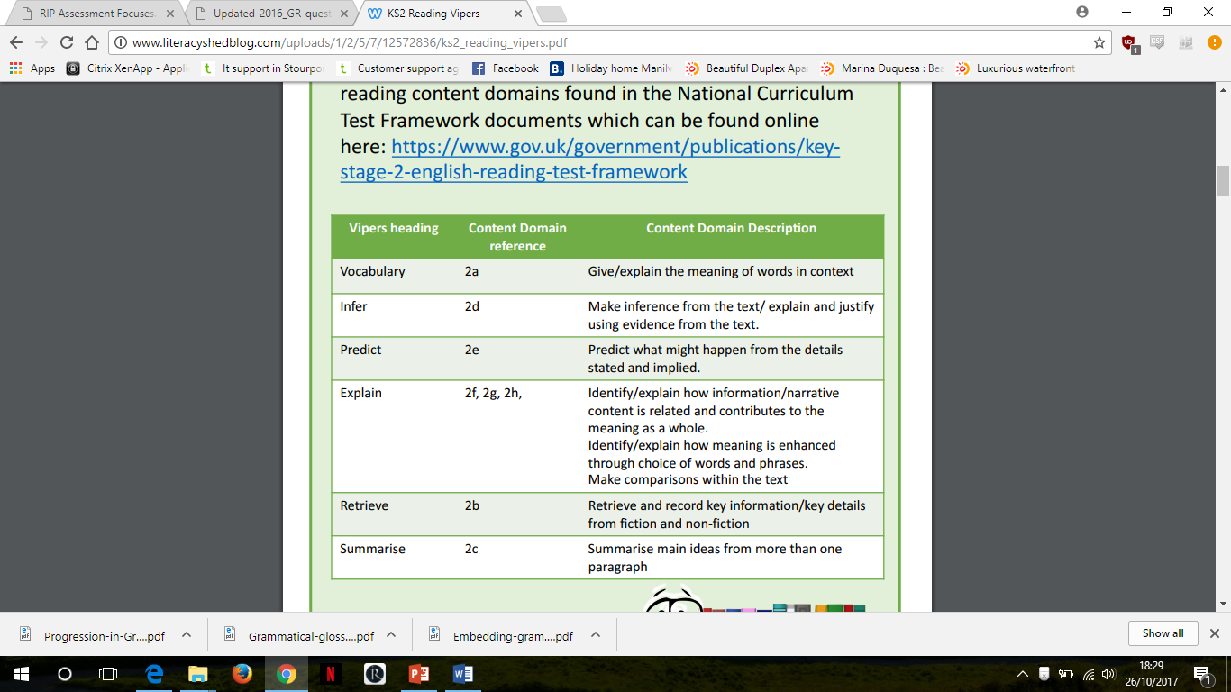
KS2 Year 3 - 6

Slide 15
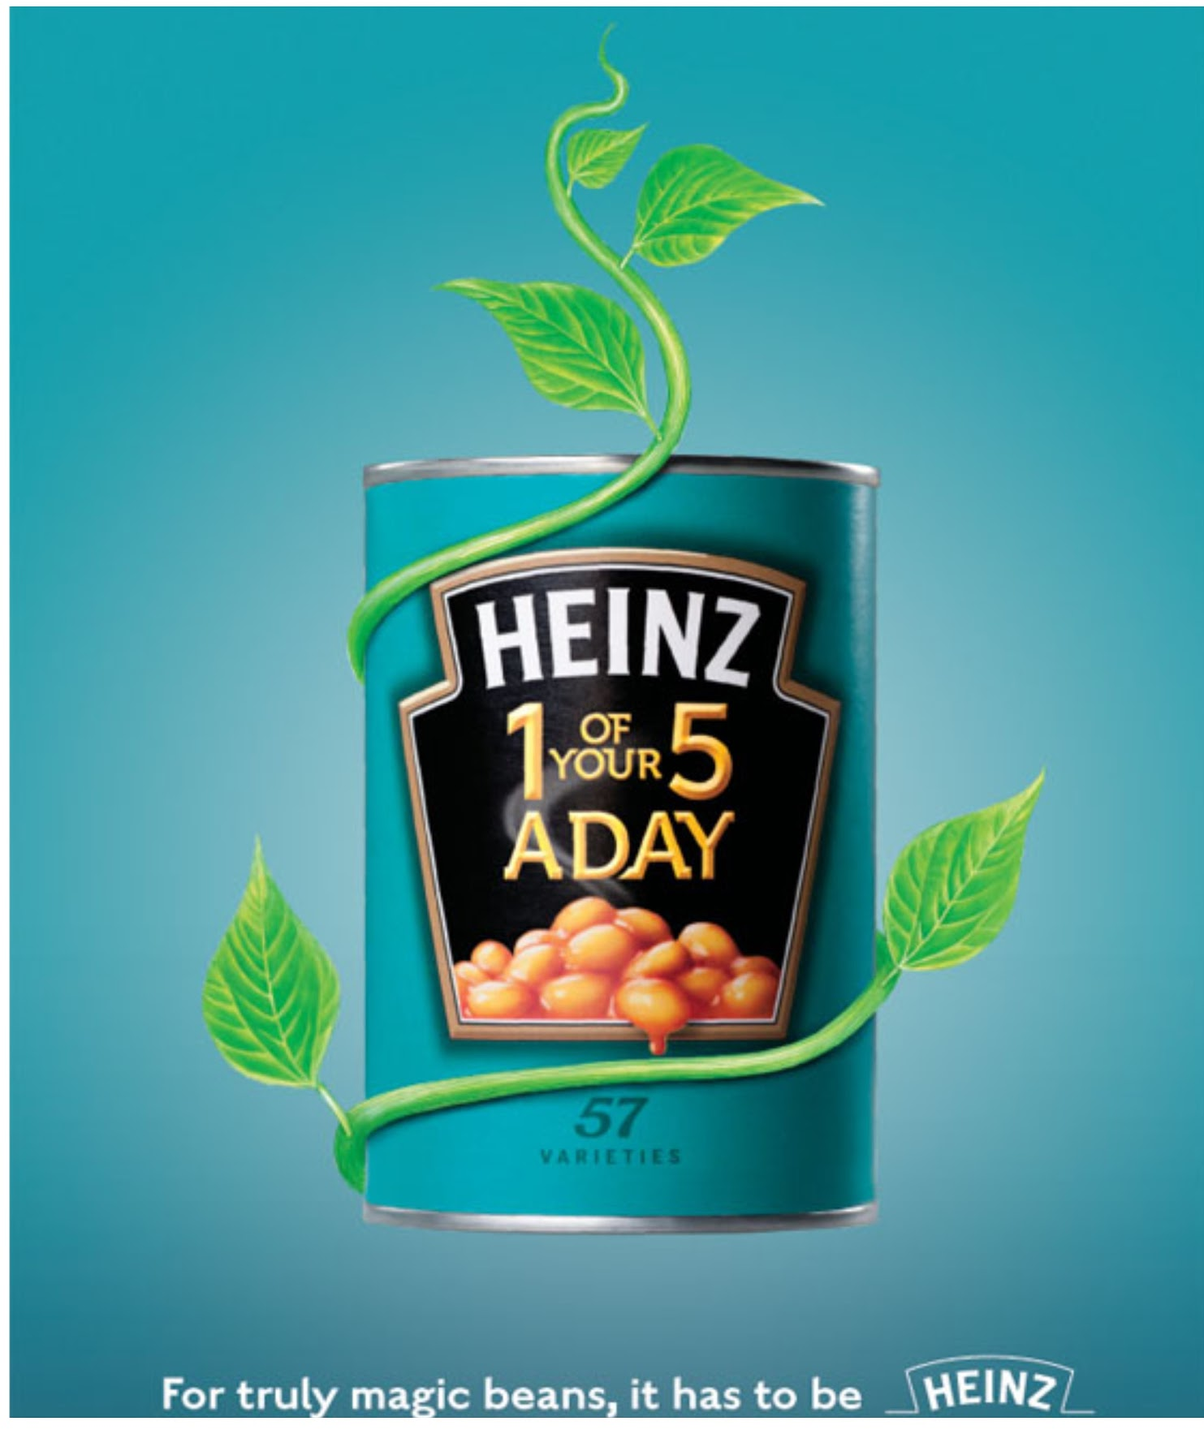
How many varieties of Heinz beans are there?
retrieval
What, on the advert, might persuade parents to feed this to their children?
inference
Explain what Heinz have done to make the beans appear to be ‘truly magic’ in this advert.
explain the author’s choices

Slide 16
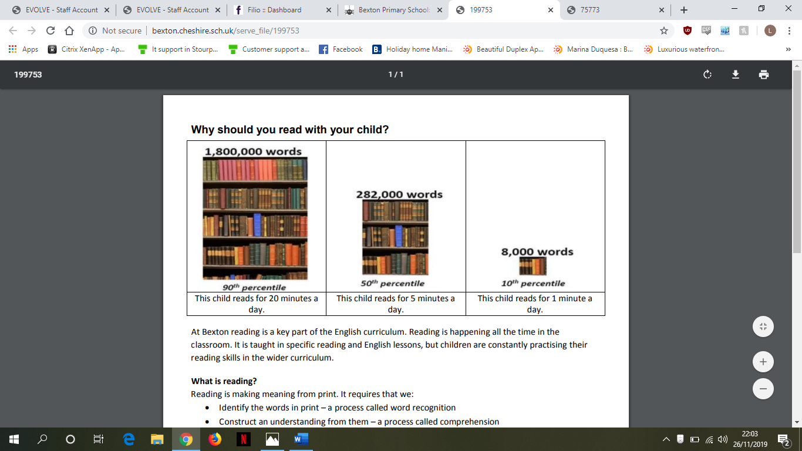
Reading at Home

Slide 17
Reading at Home – Enjoy!
Make reading visible - have books available in your home
Share books every day
Talk about books.
Sit and listen - don’t do chores around the reader!
Respect choices.
Notes:
Respect choices – reading the computer or comics or sports magazines is still reading.

Slide 18
What to do if your child is stuck
Use phonics first. What sound does the word begin with? Can you say the sounds in the word? Blend them together.
Read to the end of the sentence. What would make sense?
What is the text about – what might fit here?
Does it sound right?
Look at the picture. Does it help?
Notes:
Talk through each strategy and explain what each will do to help the child decode a word that they cannot read.
Independent Strategies
by Jill Marie Warner

Slide 19
How to use these strategies at home
John let his pet frog go.
It ******across the grass.
What is the first sound?
It h***** across the grass.
What would make sense?
It hopping across the grass.
Does that sound right?
It hopped across the grass.

Slide 20
Talking about books
It is not a test!
Do you like this book; why?
Who is your favourite character?
Tell me about a character in the book.
Which words tell you what the character is like?
How would you feel?
What do you think will happen next?
What would you do?
What have you learned about …… in your book?
What can you tell me about…?

Slide 21
Hearing your child read
Choose a quiet time and give your child your full attention
Give support if required using the strategies explained earlier;
Explain the meaning of new words;
Talk about the text using open questions.
Notes:
With a colleague role-play a home-reading session.
Pretend to struggle with some words and demonstrate how to support the reader.
Scan the book onto PPT slides so that the parents can see the book as you listen to the ‘child’ read.

Slide 22
Hearing your child read
As part of their weekly homework challenge, we encourage children to read regularly at home and ask that you sign their reading diary at least 3 times every week.
Reception, Year 1 and Year 2 children will need to read at least 3 x a week for 10 minutes
Year 3 & 4 children will need to read at least 3 x a week for 20 minutes
Year 5 & 6 children will need to read at least 3 x a week for 30 minutes.
Notes:
With a colleague role-play a home-reading session.
Pretend to struggle with some words and demonstrate how to support the reader.
Scan the book onto PPT slides so that the parents can see the book as you listen to the ‘child’ read.

