Slide 1

Friendship and bullying workshop.
Friday 20th March

Slide 2

Aims of the session
Friendships
What is bullying?
Types of bullying
What we do as a school to prevent bullying?
How we deal with bullying?
What to do if you are concerned about bullying?

Slide 3
Developing Friendship Skills
School is the place where children learn to navigate the world of friendships. At this age, alliances often shift and change. Learning to make friends and get along with peers can cause some distress to most children.

Slide 4
https://www.bbc.co.uk/bitesize/topics/zhjxfg8/watch/zhhpb9q

Slide 5
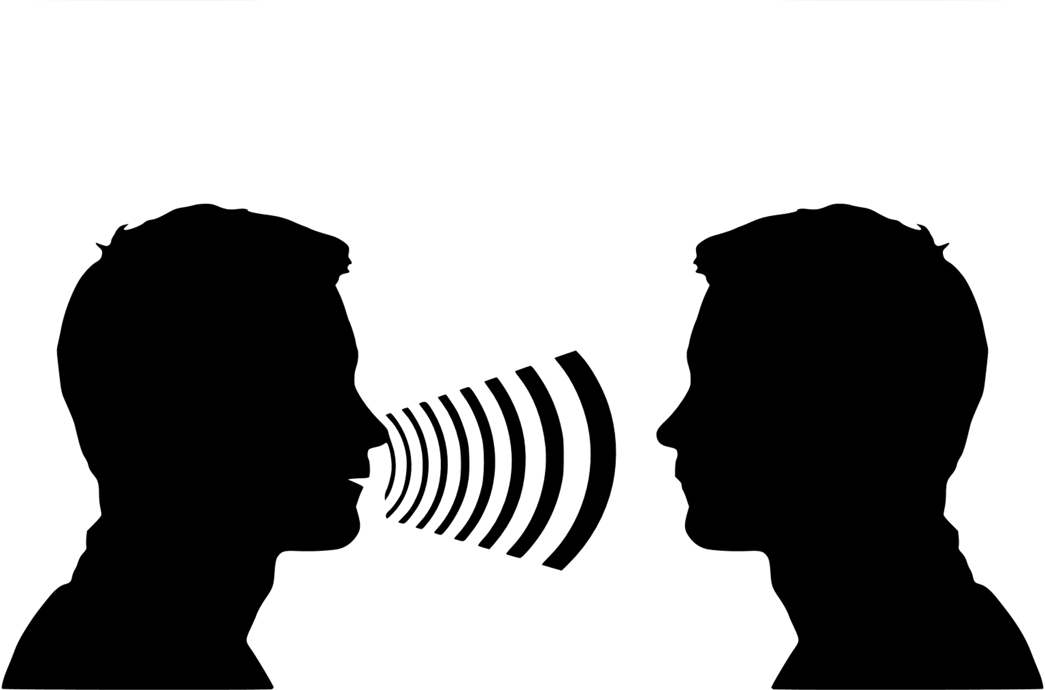
How can parents help?
It is important to listen to your child’s experiences with peer challenges.

Slide 6

How can parents help?
Instead of telling them what to do, help them problem-solve, and also to clarify and understand their feelings.

Slide 7

How can parents help?
It is always best to stay away from taking sides with either child- offer empathy for all of your child’s feelings, and also reflect together on how their peer might be feeling.

Slide 8
How can parents help?
Coach your child to stand up for themselves using their words and help them learn to express their needs rather than attacking their friend. It is helpful to practice this together!

Slide 9

W
I
N
E
Wondering (child’s feelings and behaviour).
Imagining (what they are experiencing).
Noticing (behaviours in a non-judgemental way).
Empathy (responding with understanding).

Slide 10
What is bullying? (DfE)
Bullying is behaviour by an individual or group, repeated over time, that intentionally hurts another individual or group either physically or emotionally. Bullying can take many forms … …and is often motivated by prejudice against particular groups, for example on grounds of race, religion, gender, sexual orientation, special educational needs or disabilities, or because a child is adopted, in care or has caring responsibilities. It might be motivated by actual differences between children, or perceived differences.

Slide 11
Types of bullying
  Physical
  Verbal
  Social/emotional
      Cyber

Slide 12
What causes a child to be a Bully?
Like Parent, Like Child
Children model what they see. If a child is bullied by his/her parent, or is being abused or treated in a disrespectful way at home, that child is likely to imitate this behaviour at school. They are learning from their parent that this type of behaviour is acceptable.

Slide 13
What causes a child to be a Bully?
The Powerless Child
Sometimes, the child that bullies is the child who feels completely powerless at home. Perhaps this child is abused, or watches one of his parents abuse another parent and he/she is left feeling scared and powerless at home. This child may attempt to gain back power by bullying others at school.

Slide 14
What causes a child to be a Bully?
The Forgotten Child
Children who feel invisible at home act out as bullies at school. Children need constant love and respectful attention from the adults who care for them — and they want and need it most from their mother and father. They may feel voiceless and un-important. That feeling of invisibility may turn into anger, resentment and then bullying others at school.

Slide 15
What causes a child to be a Bully?
The Entitled Child
Then there is the child who has been given too much power. I have seen children who are given everything they want, raised without limitations and rules to follow, who then grow up to feel entitled and all-powerful. These children may believe they have a right to bully others at school, since they bulldoze their parents at home.

Slide 16
What causes a child to be a Bully?
Children who lack Empathy
Finally, there are those children who come from wonderful, loving homes with actively involved parents who become bullies. These child bullies may simply lack empathy, like to dominate, are possessive and want power. The wonderful thing about this is that empathy is something that can be taught.

Slide 17
What causes a child to be a Bully?
Children who Bully are still children
It is important to remember that children who bully are still children. They are acting that way for a reason, and they, too, need help and guidance from adults. In my experience, bullies may not have healthy social behaviours, empathy, or coping skills. This has the potential to lead to a lifetime of relationship problems, general parenting problems, and even problems with the law.
Who’s fault is this? Yet the child is blamed

Slide 18
What do we do to prevent
bullying?
School Values
Class Charters
PSHE
Assemblies
Policy and Procedure Review
Communication

Slide 19
Through the Curriculum we develop…
PSHE Skills
  Self-awareness
Managing feelings
Motivation
Empathy
Social skills

Slide 20
How do we deal with bullying?
Listen to the children
Investigate
Support
Follow up
Monitor
Clear lines of communication

Slide 21
What parents should do if
they are concerned
Listen and support your child
Make sure they know you have taken it seriously
Reassure them they have done the right thing by speaking out
Contact class teacher
Clear lines of communication
Follow up meetings

