Slide 1

Knowledge organizers and learning in the classroom.
Friday 8th May

Slide 2

Aims of the session
Understand what a knowledge organizer is.
How we use key vocabulary and assessment.
How this links into classroom practice.

Slide 3
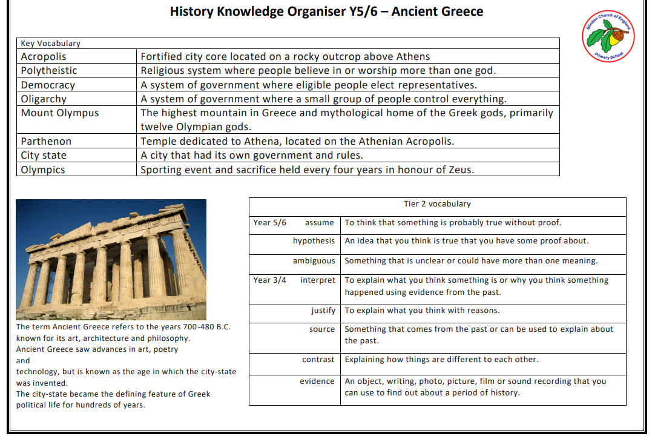

What is a knowledge organizer?

Slide 4
Which subjects?
Science.
History.
Geography.
RE.
PSHE.
Computing.

Slide 5

Vocabulary.

Slide 6
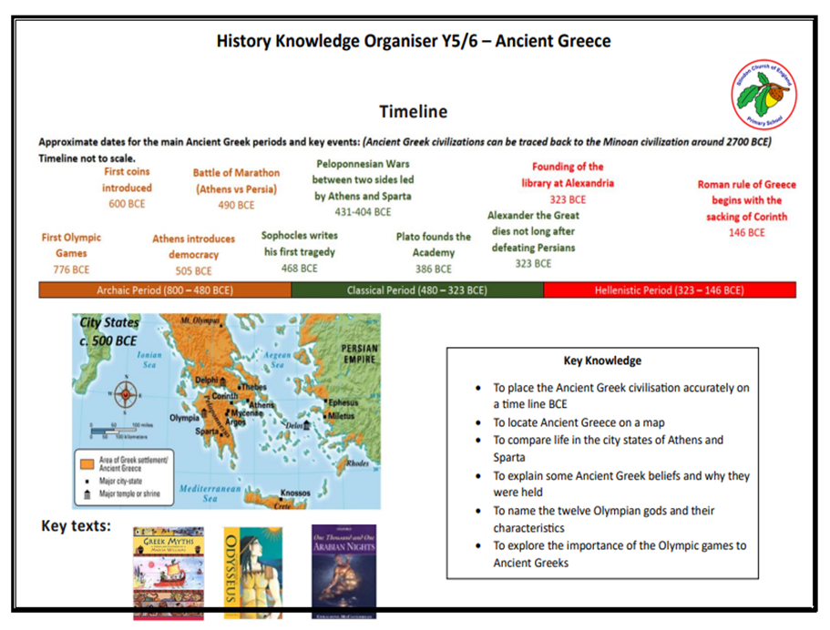
Key knowledge.

Slide 7
Assessment.

Slide 8
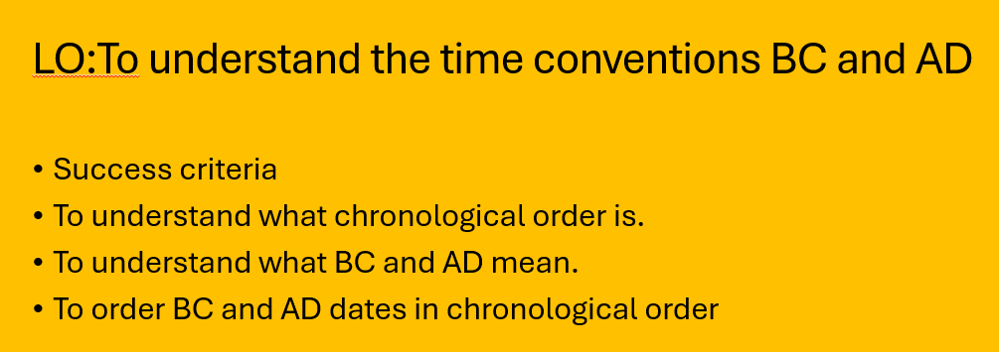
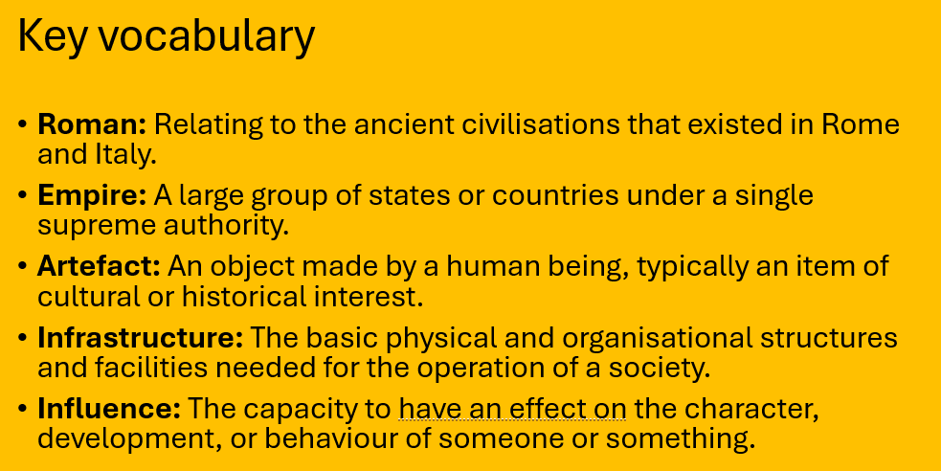
Learning in the classroom.
Every lesson has:
Retrieval practice- recall.
Learning objective= LO.
Key vocabulary.

Slide 9
Learning in the classroom.
Every lesson has:
Modelling.
Core questioning.
Task.

