Slide 1

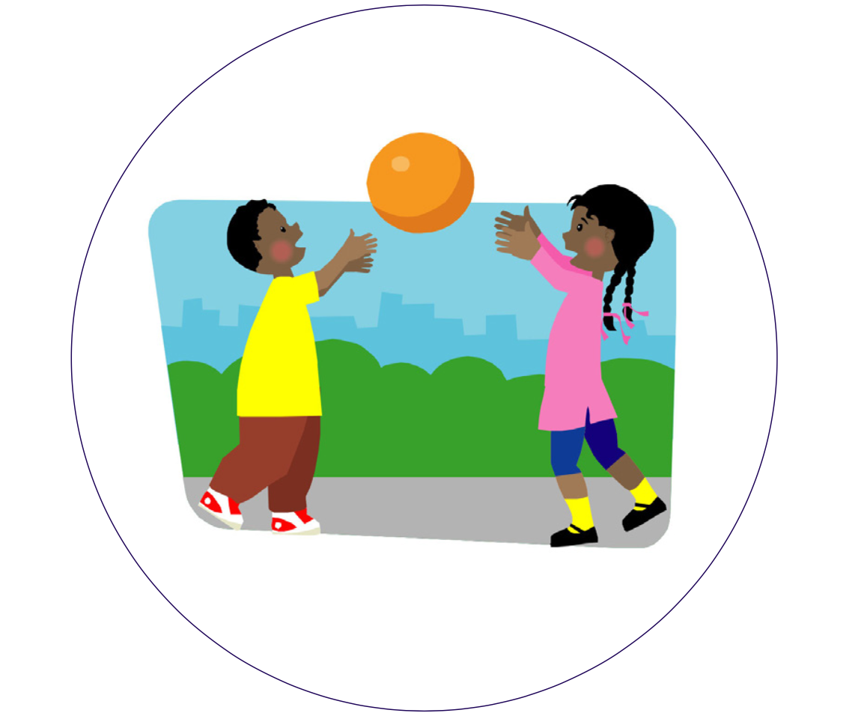
Hazel PSHE Knowledge Organiser
Autumn Term 2 - Mental health and wellbeing
Friendship
Books to help with this topic:
Friends, Kathryn Cave and Nick Mayland
Rosie and the yellow ribbon, Paula
DePaolo
Two friends, Clara Vullamy
Iʼm not invited, Diana Cain Bluthenthal
Hello – Jack Foreman
Friends, Kim Lewis
Key Vocabulary
friend | Someone that is special to you
friendship | When people are friends
excluded | Being left out
argument | When you disagree with someone
falling out | When a friendship goes wrong
What we should know and what we should be able to do:
To learn about special people in our lives
I can identify people who are special to me and explain why
I understand what makes a good friend
I can demonstrate how to show someone I care
To learn about making friends and who can help with friendships
I understand how people might feel if they are left out or excluded from friendships
I recognise when someone needs a friend and know some ways to approach making friends
I know who I can talk to if I am worried about friendships
Pupils learn about solving problems that might arise with friendships
I can identify some ways that friendships can go wrong
I can describe some ways to sort out friendship problems
I recognise that difficulties within friendships can usually be sorted out
Questions to think about …
What makes a good friend?
Which people are special to me?
What can I do to make new friends?
How does it feel if you are left out of a game?
Is it sometimes hard to make friends?
What can help make friendship stronger?
Useful Websites:
Always talk to someone who helps keep you safe, such as a parent, teacher or other adult you trust.
ChildLine: 0800 1111 www.childline.org.uk

